Slide 1
/Our project of permaculture/
A project for our Earth !

Slide 2
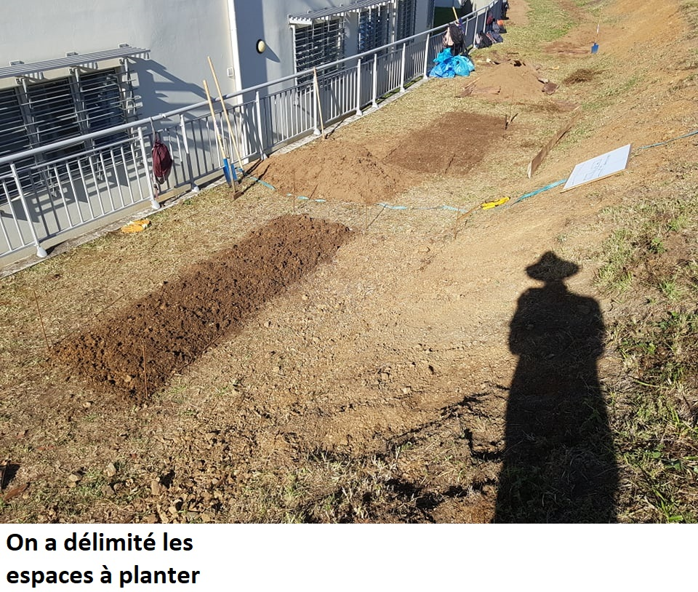
We were very happy to do that.
The sun was so hot
I don’t know if you see, but we had tools to help us.
^_^
Places for plants were delimited. ☺
On a délimité les espaces à planter !

Slide 3
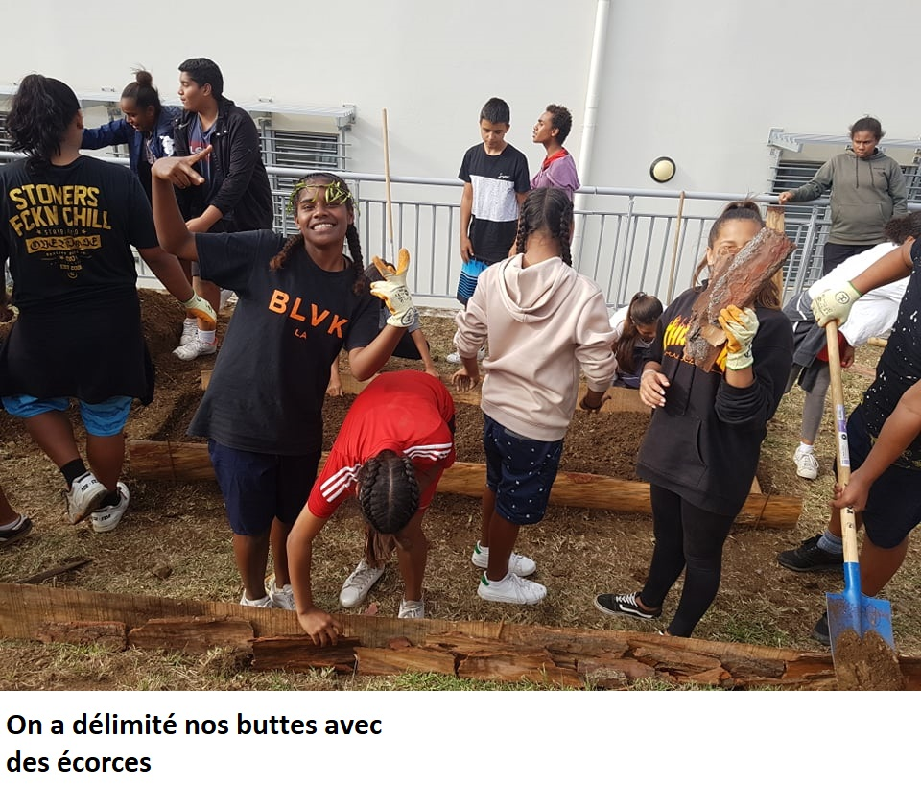
Everyone helped for mounds !
Nobody was bored !
A smile on every face!
Happinesswas here ☺.
Mounds were delimited with barks. ☺
On a délimité nos buttes avec des écorces !

Slide 4
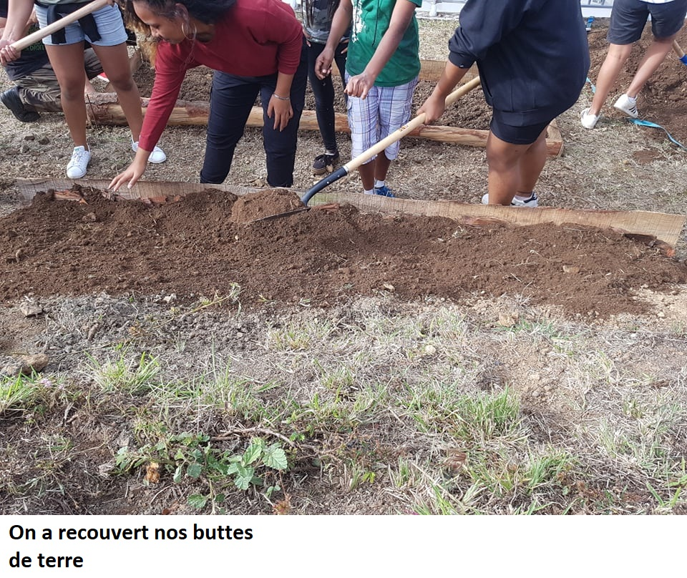


Yay !
!
The mounds were covered with ground. ☺
On a recouvert nos buttes de terres !

Slide 5
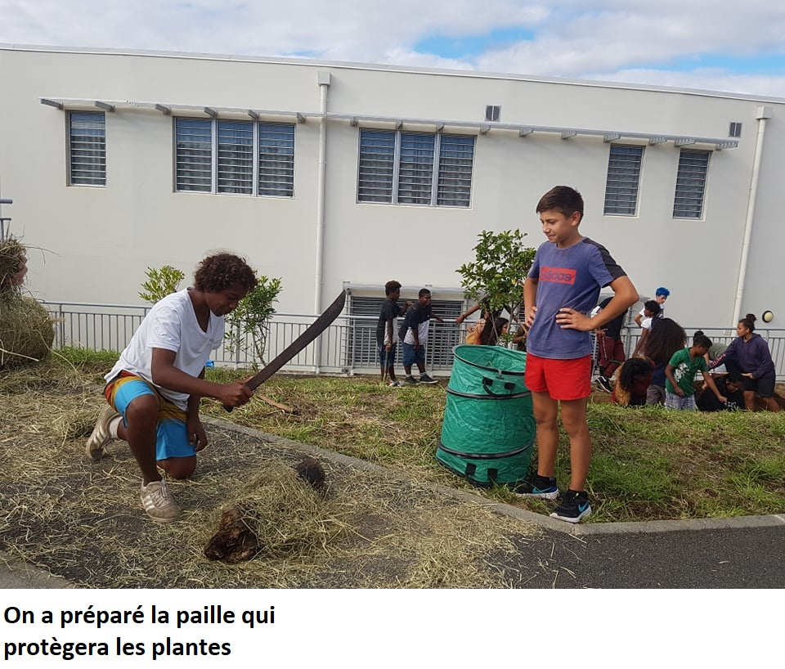
Straw to protect plants was prepared. ☺
On a préparé la paille qui protégera les plantes !

Slide 6
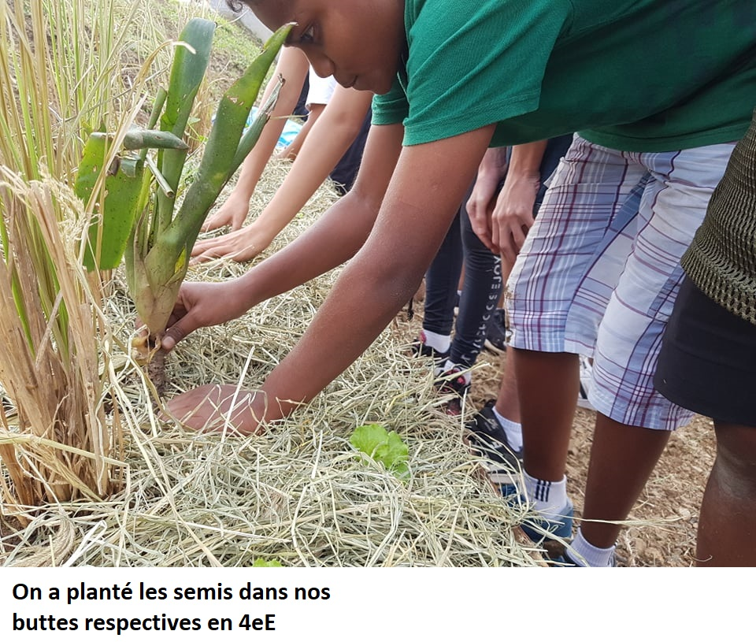
Seedlings were planted on our mounds by grade 9 E. ☺
On a planté nos semis dans nos buttes respectives en 4ème E.

Slide 7
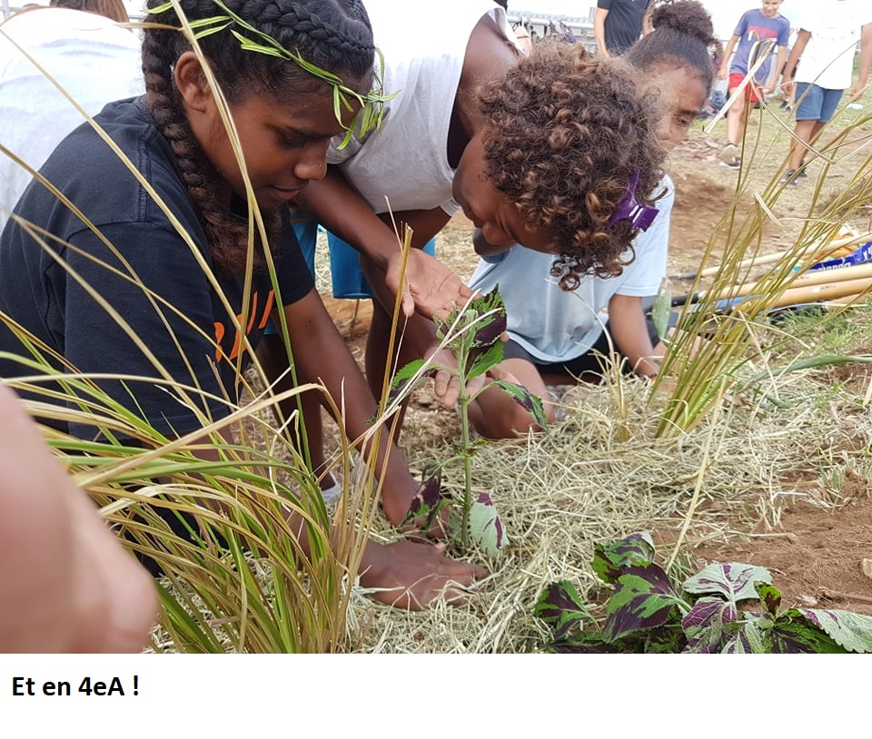
The Same in Grade 9 A !
Pareil en 4ème A !

Slide 8
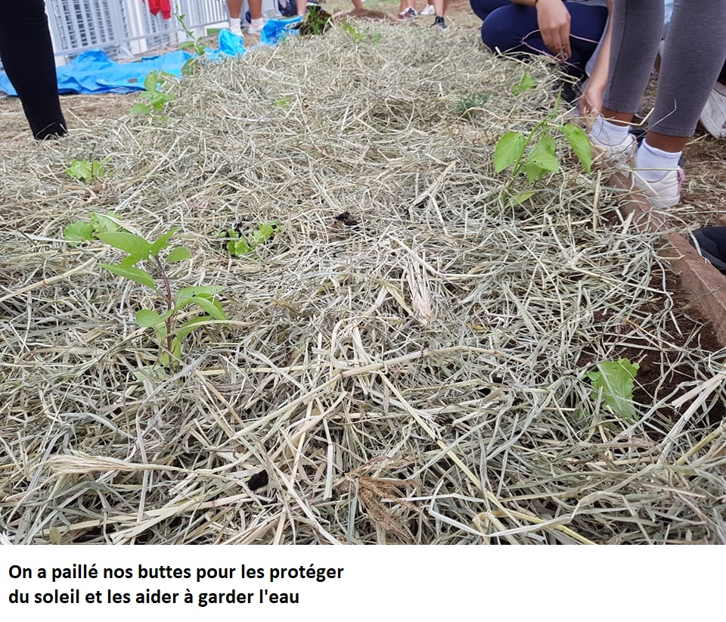
Yay !
The mounds have been mulched to protect them from the sun and help them to save water !
On a paillé nos buttes pour les protéger du soleil et les aider à garder l’eau !

Slide 9
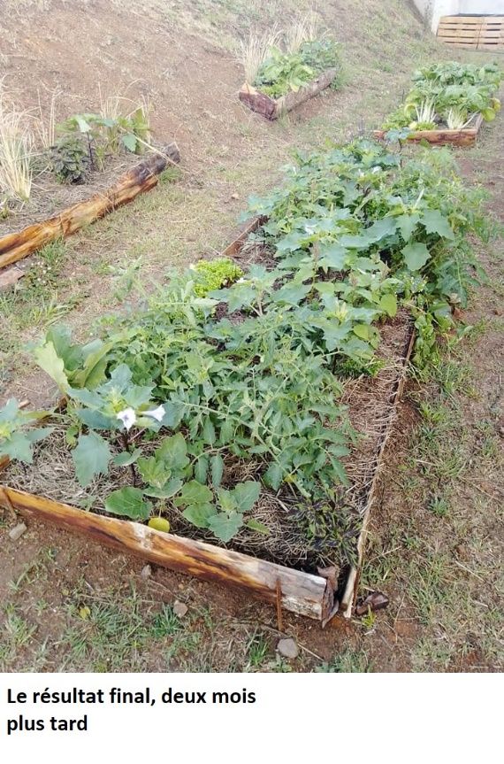
2 months later, we can see the final result !
2 mois plus tard, nous pouvons voir le résultat final !

Slide 10
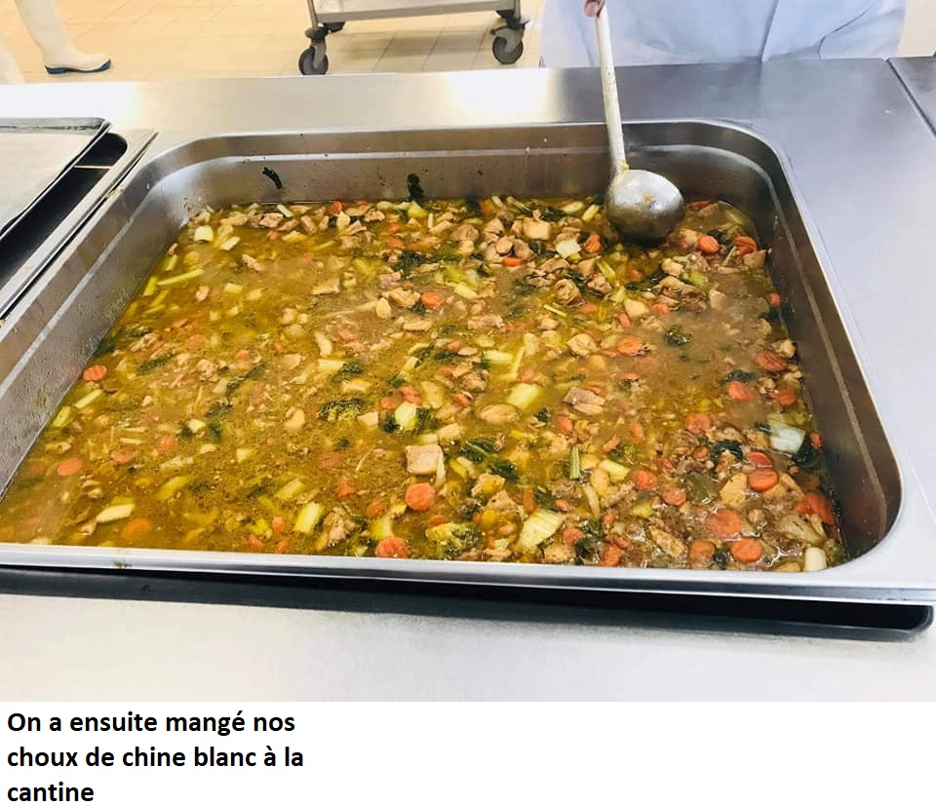
I am so hungry when i see it !
So delicious !
More, more and more !
After that, our vegetables were eaten and it was very good ! ☺.
On a ensuite mangé nos choux de chine blancs à la cantine !

Slide 11
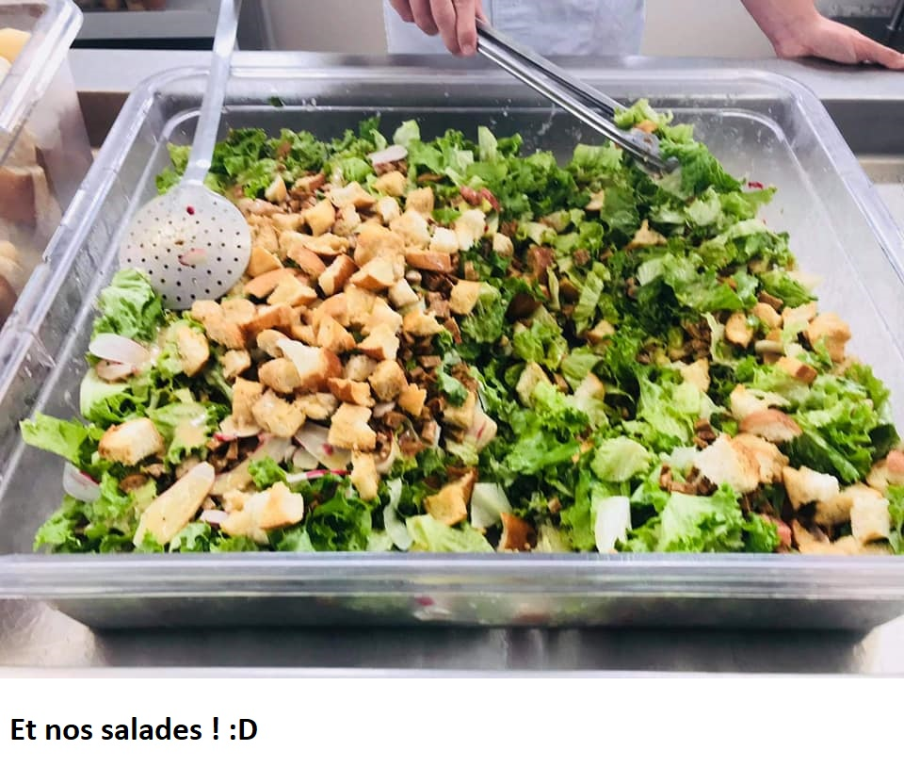
I want more !
We should do that more often !
Good for health !
« Wow ! It’s very cool because we eat something from our mounds ! »
And finally, we have eaten our lettuce ! :D
Et aussi nos salades ! ^^

Slide 12

It was a very good project :D
If we have done this project, it’s to protect our planet !
What about you ? ;)

