Slide 1
Riding Zone
The channel of
Xtreme Sports

Slide 2
Our favorite tv program.

Slide 3

When?
On chanel: 11 on
Sunday at 6 pm

Slide 4
The presenter: Tiga

Slide 5
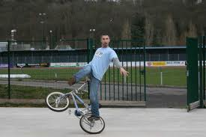

Biking

Slide 6

Skateboarding

Slide 7
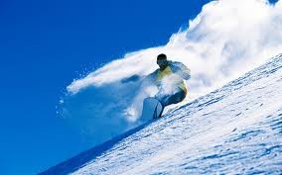
Snowboarding

Slide 8

Skiing

Slide 9
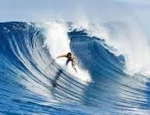

Surfing

Slide 10
Graf

Slide 11
Kiteboarding

Slide 12
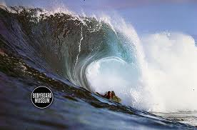
Bodyboarding

Slide 13
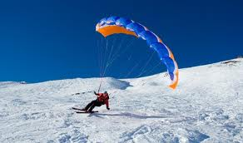
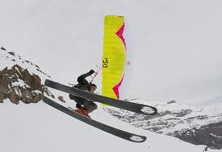
Speedfly

Slide 14

The latest clothes

Slide 15
Thank you for your attention!
Nathan and Neals

