Slide 1
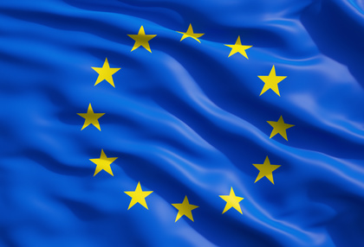
THE EUROPEAN UNION

Slide 2

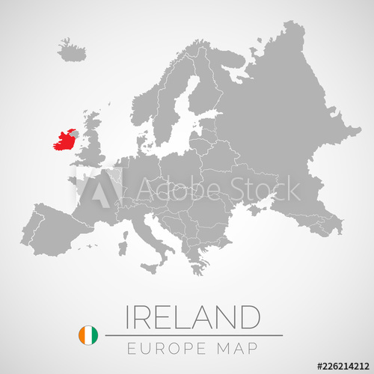
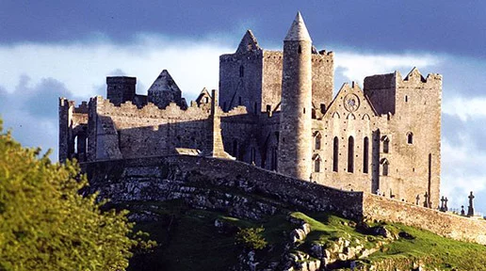
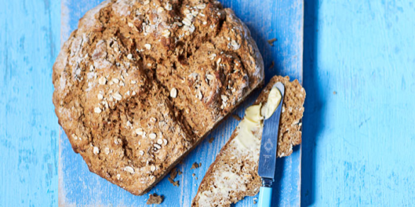
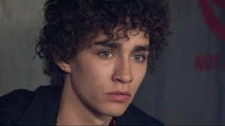
IRELAND
MEMBER OF EU SINCE :1973
HISTORICAL SITES:
Hill of Tara ,
Rock of Cashel
Ceide Fields
CULINARY SPECIALITIES:
Soda bread
Shellfish
Irish stew
PERSONALITIES:
Katie McGrath
Oscar Wilde
Robert Sheehan
CAPITAL: Dublin
OFFICIAL LANGUAGE: Irish, English
POPULATION: 4 784 000
AREA: 70 273 km²
HEAD OF STATE: Michael D. Higgins

Slide 3

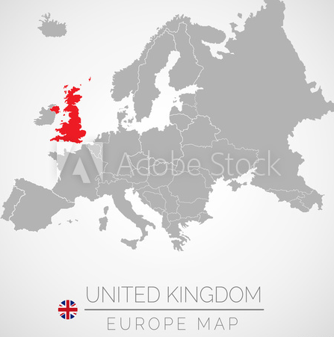
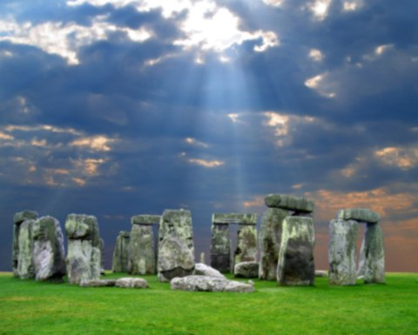
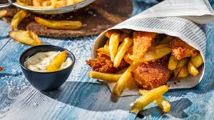
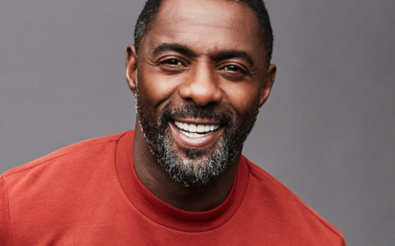
UNITED KINGDOM
MEMBER OF EU SINCE :1973
HISTORICAL SITES:
Stonehenge
Tower of London
Warwick Castle
CULINARY SPECIALITIES:
Fish and chips
Tea , Beer
Scone
PERSONALITIES:
William Shakespear
Isaac Newton
Idris Elba
CAPITAL: London
OFFICIAL LANGUAGE: English
POPULATION: 66 040 000
AREA: 242 500 km²
HEAD OF STATE: Queen Elizabeth II

