Slide 1


ITALY
ACCESSION DATE TO THE EU: 1957
HISTORICAL SITES: The Vatican, Tower of Pisa, The Coliseum
CULINARY SPECIALITIES: Pizza, Tiramisu, Risotto
PERSONALITIES: Julius Caesar, Leonardo da Vinci, Monicca Belluci, Giorgio Armani
CAPITAL: Rome
OFFICIAL LANGUAGE: Italian
POPULATION: 60 500 00
AREA: 300 000 km²
HEAD OF STATE: President Sergio Mattarella

Slide 2


GREECE
ACCESSION DATE TO THE EU: 1981
HISTORICAL SITES: Acropolis of Athens, Ancient Delphi, Minoan Palace of Knossos
CULINARY SPECIALITIES: Moussaka, Tzatziki, Blakava
PERSONALITIES: Pericles, Socrate, Maria Callas
CAPITAL: Athens
OFFICIAL LANGUAGE: Greek
POPULATION: 11 000 000
AREA: 132 000 km²
HEAD OF STATE: President Prokopis Pavlopoulos

Slide 3


SPAIN
ACCESSION DATE TO THE EU: 1986
HISTORICAL SITES: Sagrada Família, Barcelona Cathedral, The Alhambra
CULINARY SPECIALITIES: Gazpacho, Paella, Manchego cheese
PERSONALITIES: Francisco Pizzaro, Pablo Picasso, Salvador Dali, Enrique Iglesias
CAPITAL: Madrid
OFFICIAL LANGUAGE: Spanish
POPULATION: 46 500 000
AREA: 506 000 km²
HEAD OF STATE: Monarch Felipe VI
Prime Minister Pedro Sanchez

Slide 4
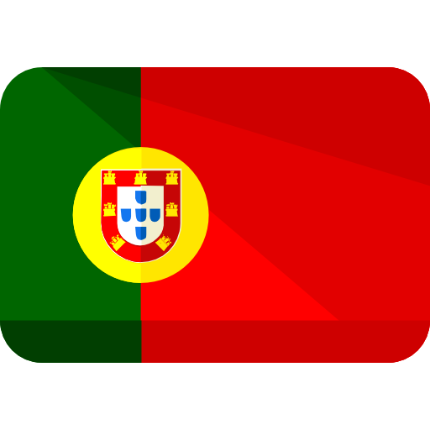

PORTUGAL
ACCESSION DATE TO THE EU: 1986
HISTORICAL SITES: Belém Tower, Hieronymites Monastery, Pena National Palace
CULINARY SPECIALITIES: Cataplana, Cozido, Porco Preto
PERSONALITIES: Vasco da Gama, Amalia Rodrigues, Cristiano Ronaldo
CAPITAL: Lisbon
OFFICIAL LANGUAGE: Portuguese
POPULATION: 10 500 000
AREA: 92 000 km²
HEAD OF STATE: President Marcelo Rebelo de Sousa

Slide 5


CYPRUS
ACCESSION DATE TO THE EU: 2004
HISTORICAL SITES: Tombs of the Kings, Kourion, Kolossi Castle
CULINARY SPECIALITIES: Börek, Gappar, Molehiya
PERSONALITIES: Makarios III, Mike Brant, Diam’s
CAPITAL: Nicosia
OFFICIAL LANGUAGES: Greek, Turkish
POPULATION: 1 250 000
AREA: 9 250 km²
HEAD OF STATE: President Nicos Anastasiades

Slide 6
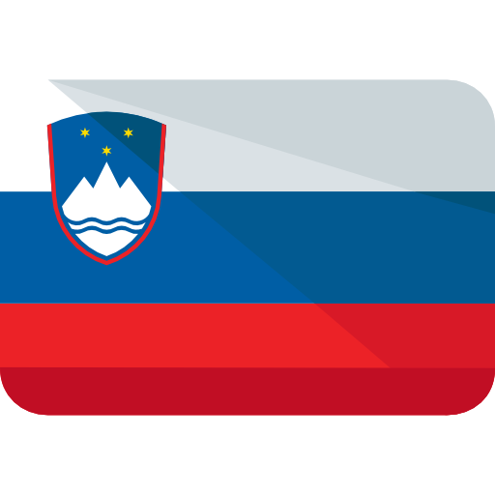

SLOVENIA
ACCESSION DATE TO THE EU: 2004
HISTORICAL SITES: Almadén and Idrija, Skocjan Caves, Ljubljana Castle
CULINARY SPECIALITIES: Belokranjska povitica, Bujta repa, Potica, Kranjska Klobosa
PERSONALITIES: Herman Potočnik Noordung, Barbara of Celje, Ita Rina
CAPITAL: Ljubljana
OFFICIAL LANGUAGE: Slovene
POPULATION: 2 066 000
AREA: 20 273 km²
HEAD OF STATE: President Borut Pahor

Slide 7


MALTA
ACCESSION DATE TO THE EU: 2004
HISTORICAL SITES: Ggantija Temples, Grandmasters Palace, Fort Rinella
CULINARY SPECIALITIES: Bragioli, Pastizzi, Ġbejniet
PERSONALITIES: Mattia Preti, George Abela, Ira Losco
CAPITAL: Valletta
OFFICIAL LANGUAGES: Maltese, English
POPULATION: 475 750
AREA: 316 km²
HEAD OF STATE: President George Vella

Slide 8
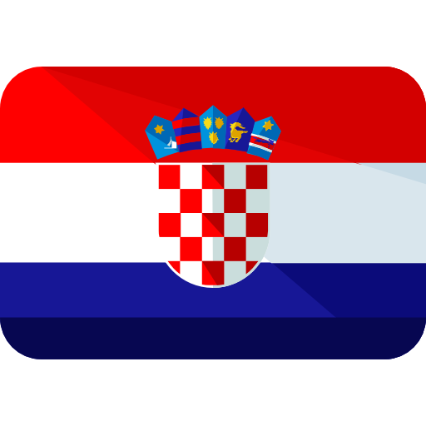

CROATIA
ACCESSION DATE TO THE EU: 2013
HISTORICAL SITES: Diocletian’s Palace, Dubrovnik City Walls, Pula Amphitheatre
CULINARY SPECIALITIES:Strukli, Pasticada, Istardi fuzi, Soparnik
PERSONALITIES:R.J. Boscovich, Ivan Mestrovic, Nikola Tesla
CAPITAL: Zagreb
OFFICIAL LANGUAGE: Croatian
POPULATION: 4 154 000
AREA: 56 600 km²
HEAD OF STATE: President Kolinda Grabar-
Kitarovic

