Slide 1
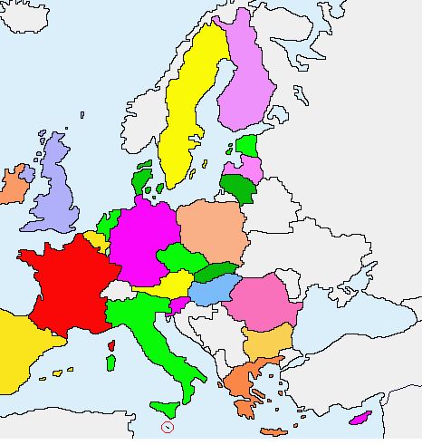
Centre and eastern countries
Latvia
Estonia
Poland
Lithuania
Czech Republic
Slovakia
Hungary
Romania
Bulgarie
Slovenia

Slide 2
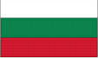
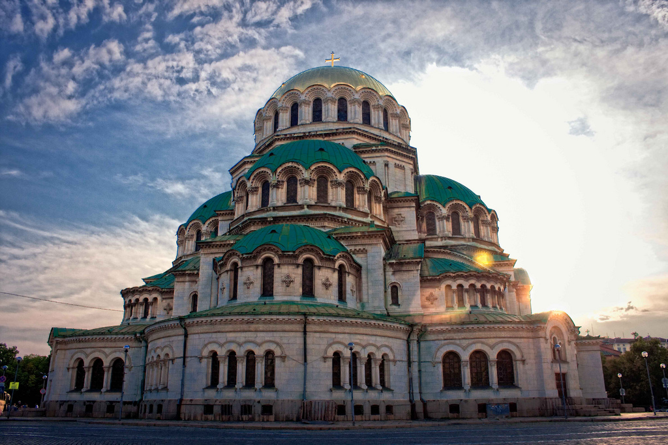
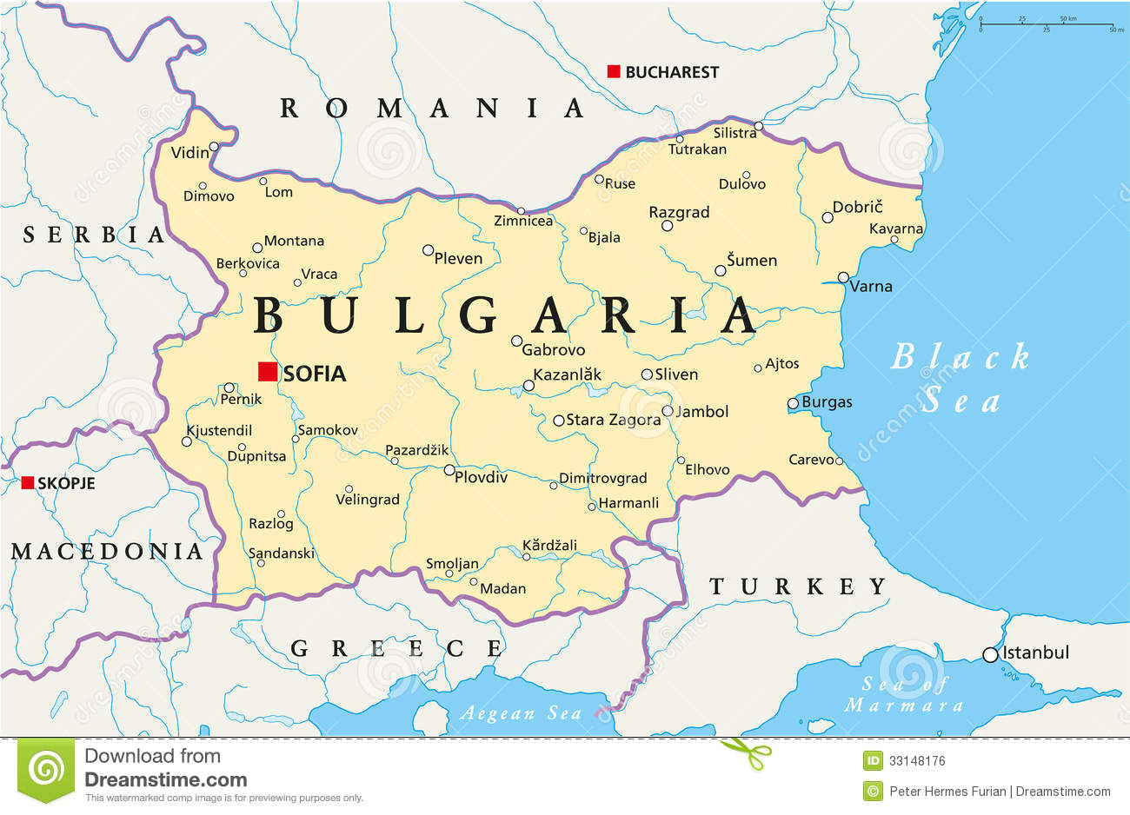
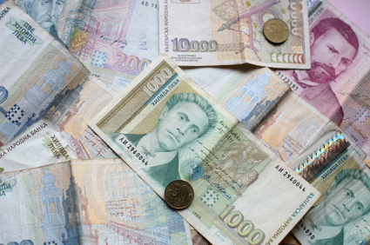
Bulgaria
Geographical size: 110 899,7 km²
Capital: Sofia
Currency: Bulgarian lev BGN
Population: 7 245 677
Population as % of total EU population: 1,4%
Official EU language: Bulgarian

Slide 3
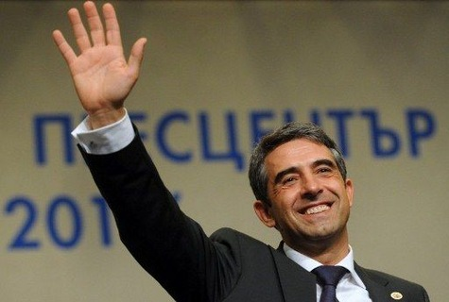
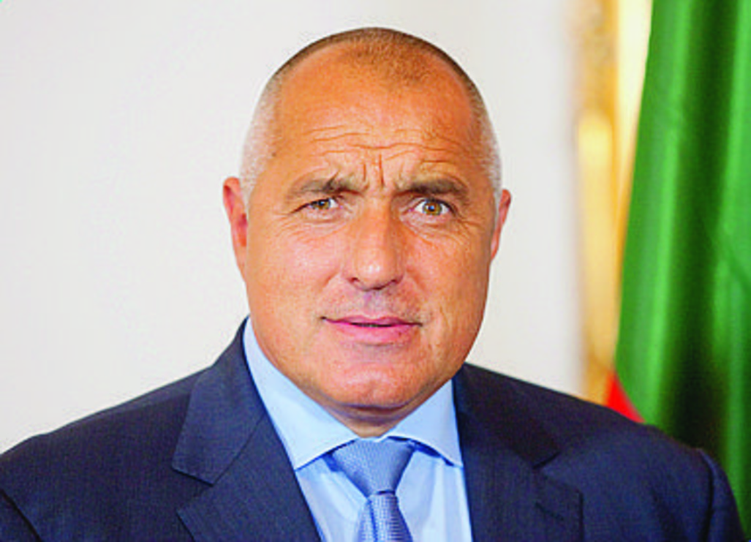
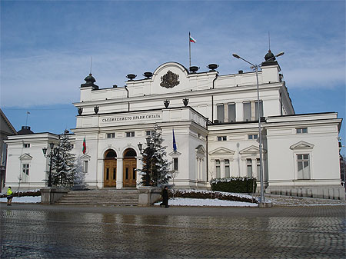
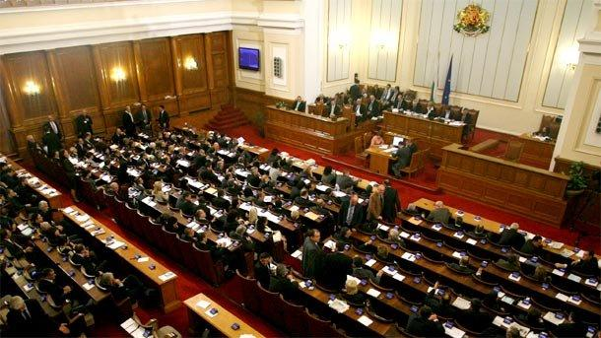
Political system: parliamentary republic
President: Rossen Plevneliev
Prime minister: Boïco Borissov
Governement
National Assembly

Slide 4
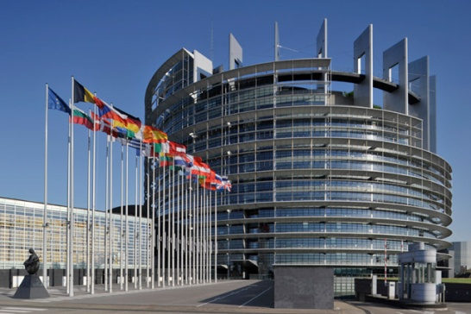
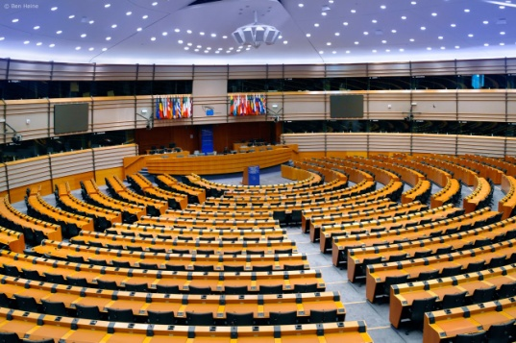
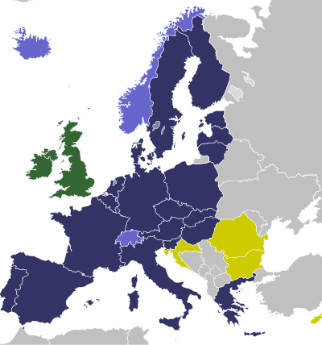
EU member country since: 1 January 2007
Seats in the European Parliament: 17
Schengen area member? No, Bulgaria is not a member of Schengen.
Presidency of the Council : Bulgaria will hold the revolving Presidency of the Council of the EU for the first time in 2018.

Slide 5
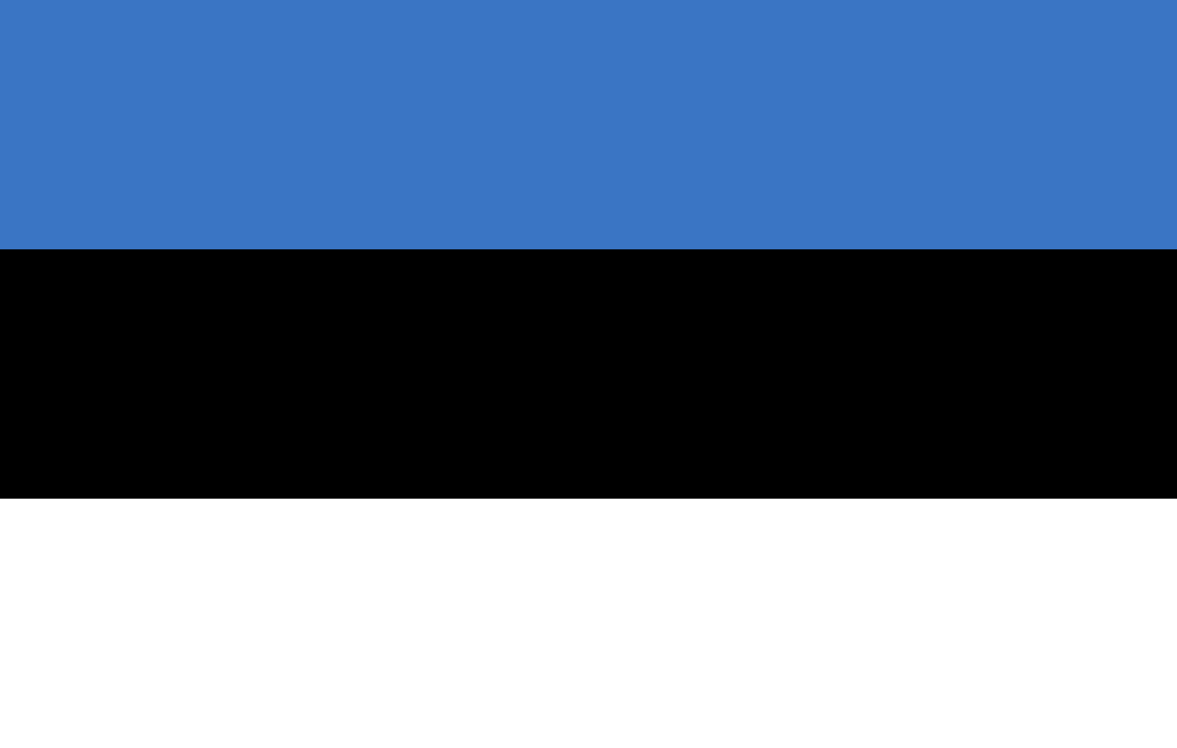
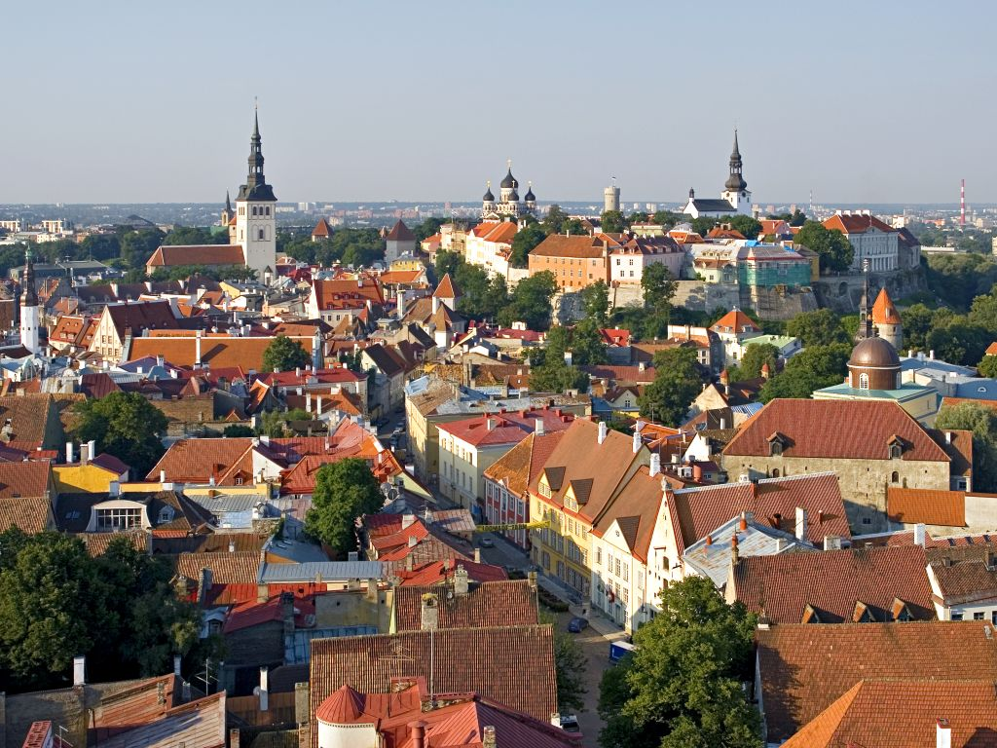
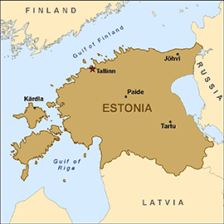
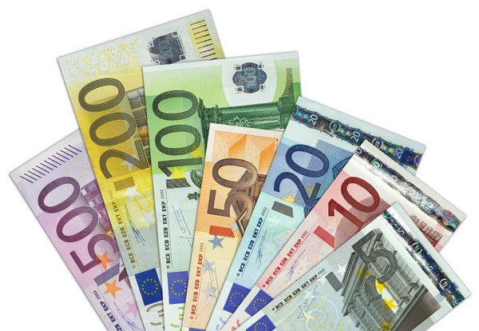
Estonia
Geographical size: 45 227 km²
Capital: Tallinn
Currency: Eurozone member since 1 January 2011
Population: 1 315 819
Population as % of total EU population: 0,3%
Official EU language: Estonian

Slide 6
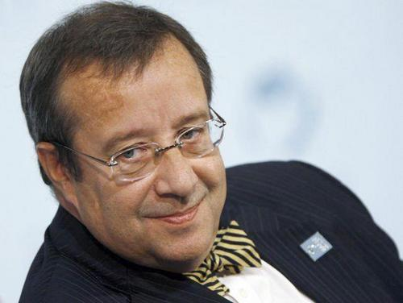
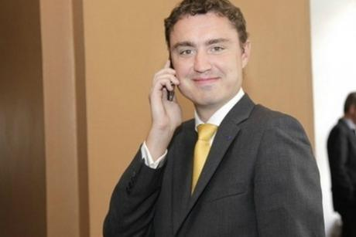
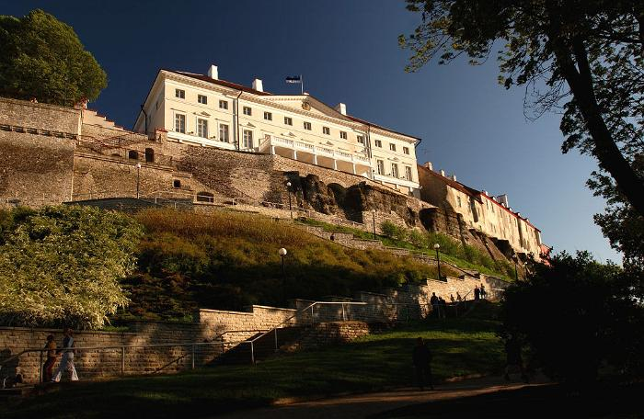
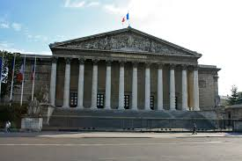
Political system: parliamentary republic
President: Toomas Hendrik Ilves
Prime minister: Taavi Rõivas
Legislature: Parliament
Government
National Assembly

Slide 7
EU member state since: 1 May 2004
Seats in the European Parliament: 6
Schengen area member? Yes, Schengen Area member since 21 December 2007
Presidency of the Council: Estonia will hold the revolving presidency of the Council of the EU for the first time in th first half of 2018.

Slide 8

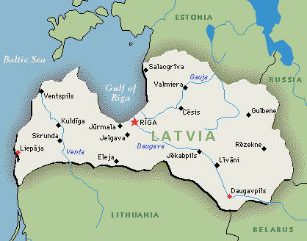
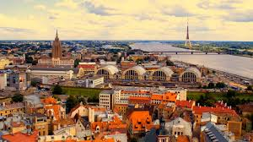
Latvia
Geographical size: 64 562 km²
Capital: Riga
Currency: Eurozone member since 1 May 2004
Population: 2 001 468
Population as % of total EU population: 8
Official EU language : Latvian

Slide 9
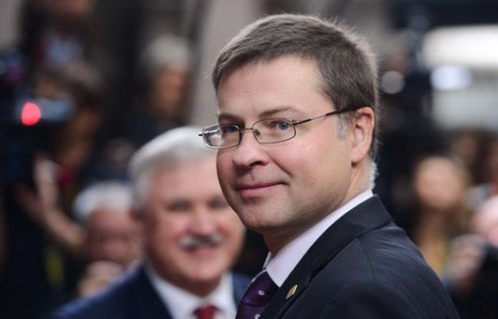
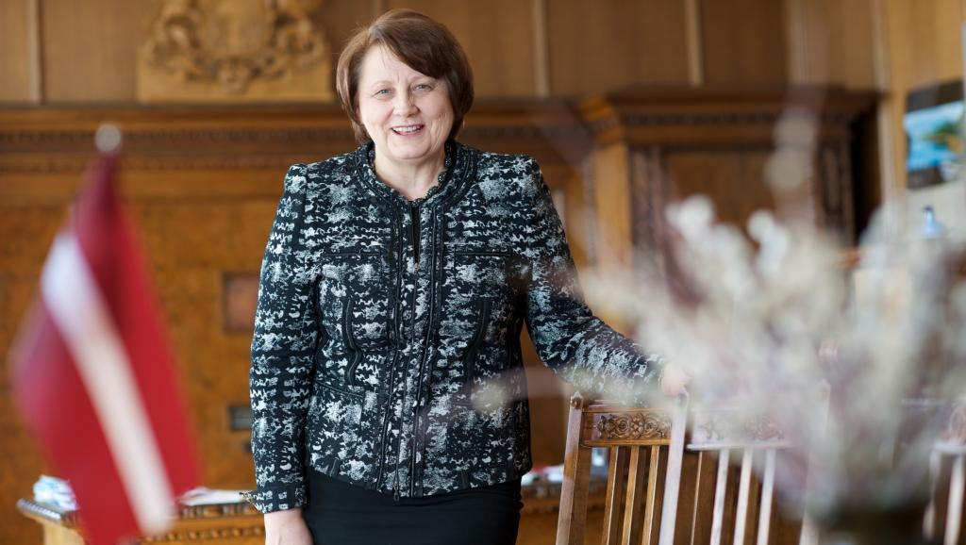
Political system: parliamentary republic
President : Andris Bērzins
Prime minister: Laimdota Staujuma

Slide 10
EU member country since: 1 May 2004
Seats in the European Parliament: 8
Schengen area member? Yes, Schengen Area member since 21 December 2007
Presidency of the Council: Latvia holds the revolving presidency of the Council of the EU for the first time in 2015

Slide 11
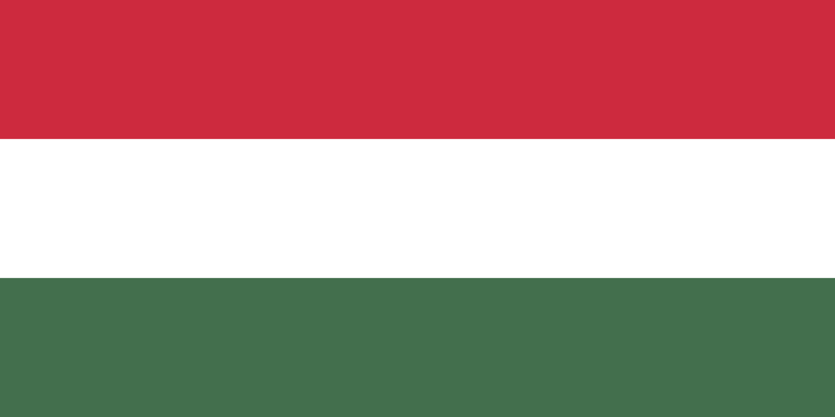
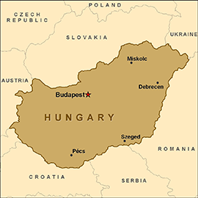
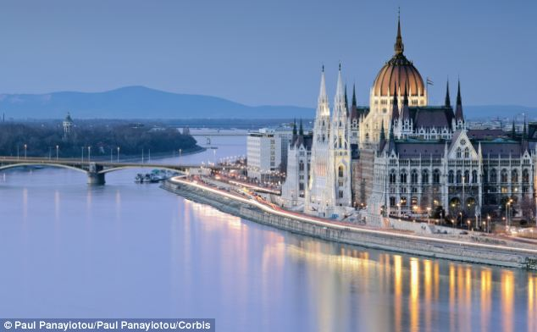
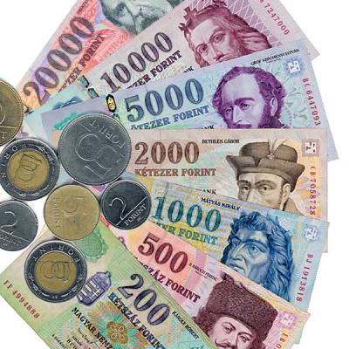
Hungary
Geographical size: 93 023,7km²
Capital: Budapest
Currency: Hungarian Forint HUF
Population: 9 879 000
Population as % of total EU population: 1,9%
Official EU language: Hungarian

Slide 12
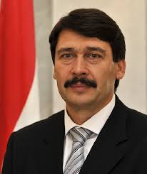
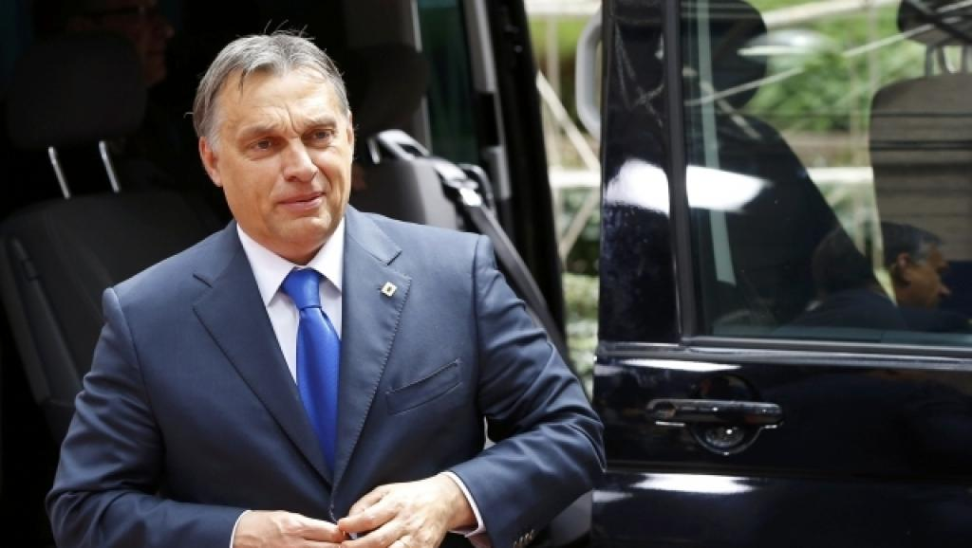
Political system: parliamentary republic
President : János Áder
Prime minister: Viktor Orbán

Slide 13
EU member country since: 1 May 2004
Seats in the European Parliament: 21
Schengen area member? Yes, Schengen Area member since 21 December 2007
Presidency of the Council: Hungary has held the revolving presidency of the Council of the EU once in 2011

Slide 14
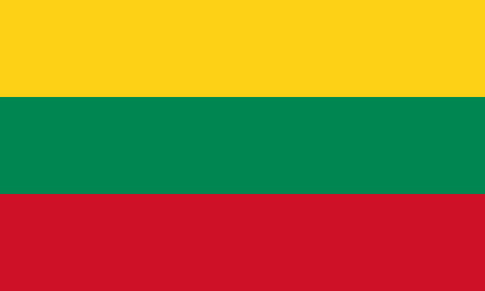
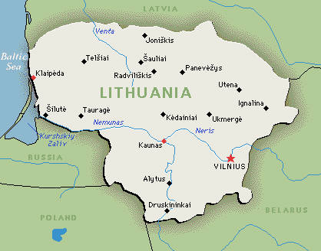
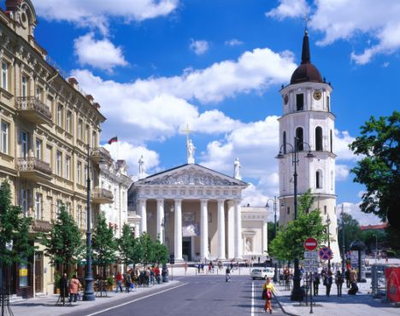
Lithuania
Geographical size: 65 300 km²
Capital: Lisbon
Currency: Member of the eurozone since 2015
Population: 2 943 472
Population as % of total EU population: 0,6 %
Official EU language: Lithuanian

Slide 15
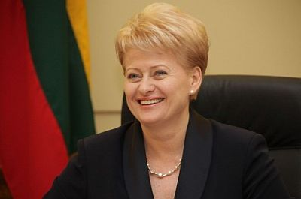
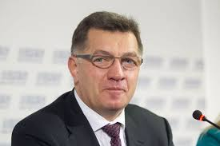
Political system: parliamentary republic
President: Dalia Grybausjaitè
Prime Minister: Algiradas Butkevičius
Assembly President:

Slide 16
EU member country since: 1 May 2004
Seats in the European Parliament: 11
Schengen area member? Yes, Schengen Area member since 21 December 2007
Presidency of the Council: Lithuania has held the revolving presidency of the Council of the EU once in 2013.

Slide 17
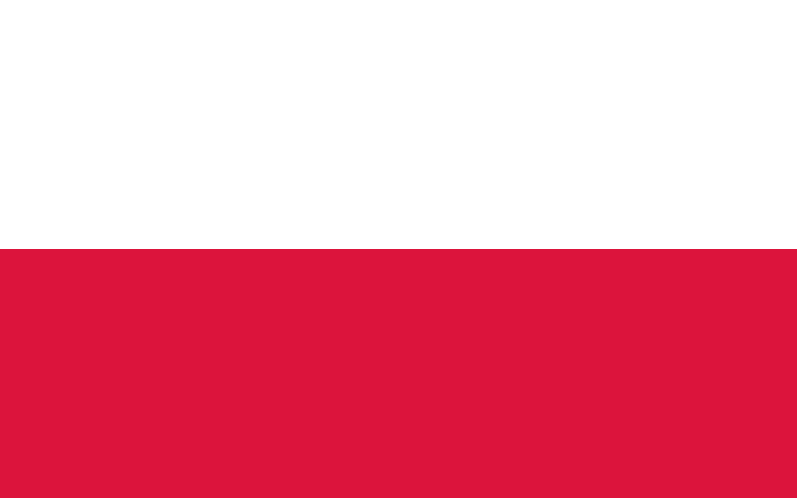
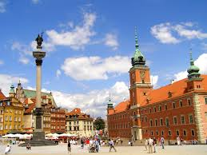
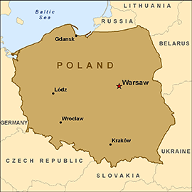
Poland
Geographical size: 312 679km²
Capital: Warsaw
Currency: Eurozone member since 2015
Population: 38 495 659
Population as % of total EU population: 7,6%
Official EU language: Polish Zloty PLN

Slide 18
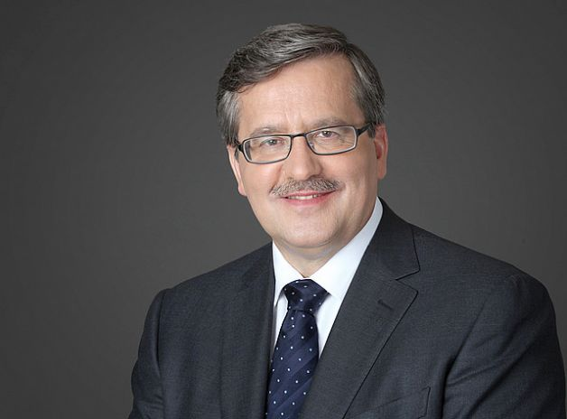
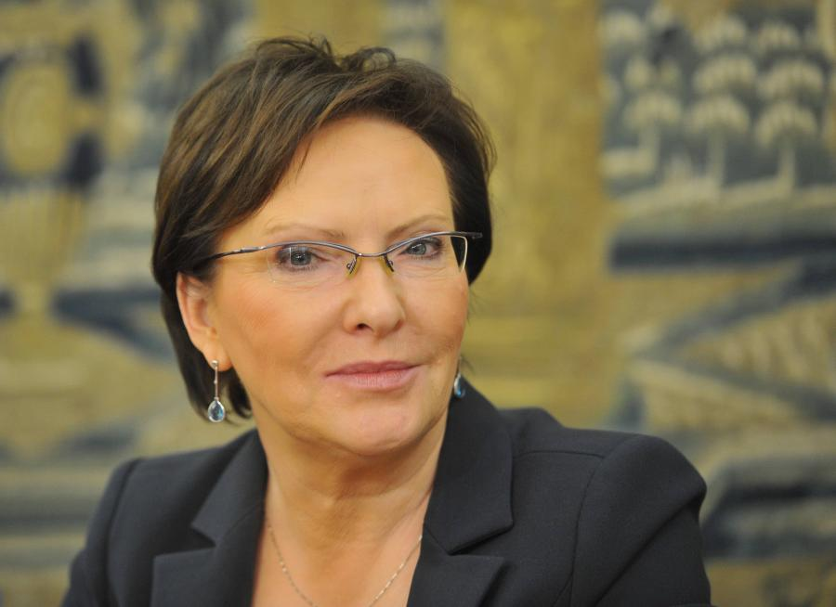
Political system: Parliamentary republic
President: Bronislaw Komorowski
Prime Minister: Ewa Kopacz

Slide 19
EU member country since: 1 May 2004
Seats in the European Parliament: 51
Schengen area member? Yes, Schengen Area member since 21 December 2007
Presidency of the Council: Poland has held the revolving presidency of the Council of the EU once in 2011

Slide 20
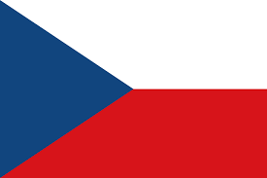
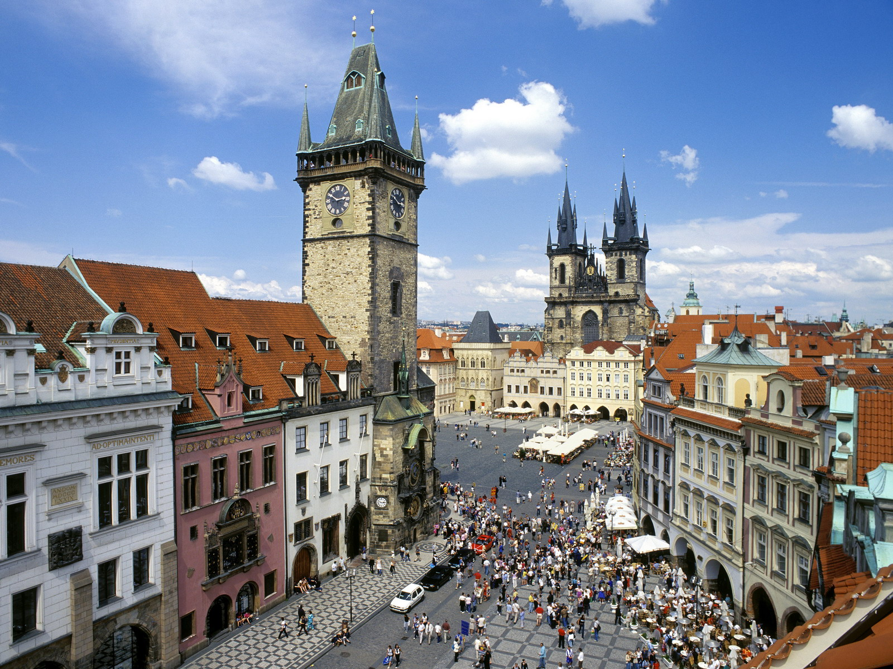
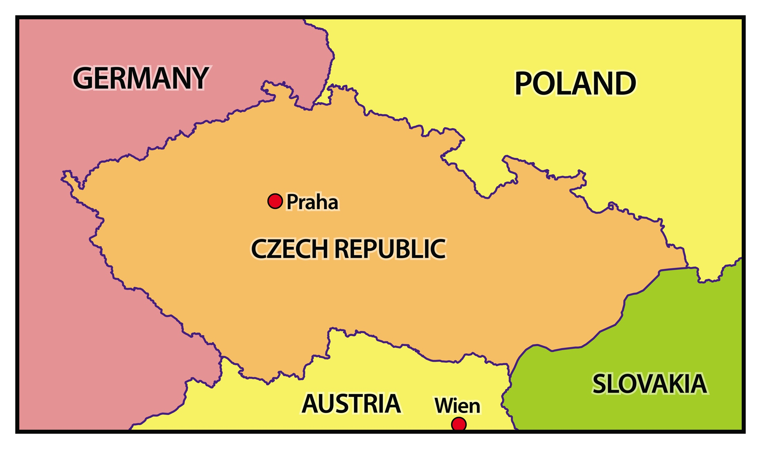
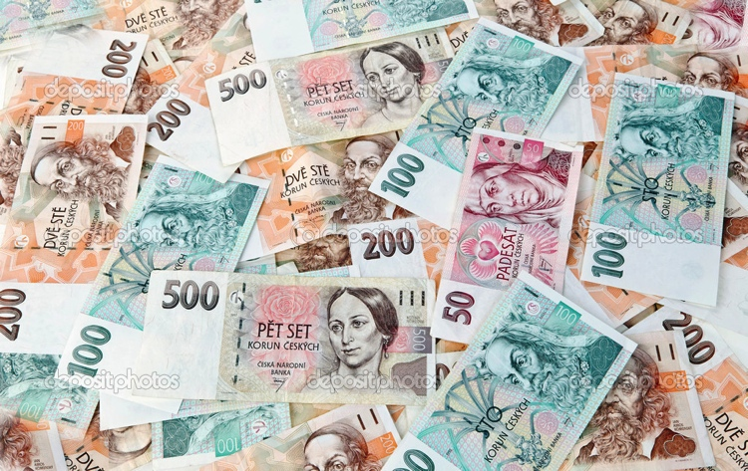
Czech Republic
Geographical size: 78 866,2 km²
Capital: Prague
Currency: Czech koruna (CZK)
Population: 10 512 419
Population as % of total EU population: 2,1 %
Official EU language: Czech

Slide 21
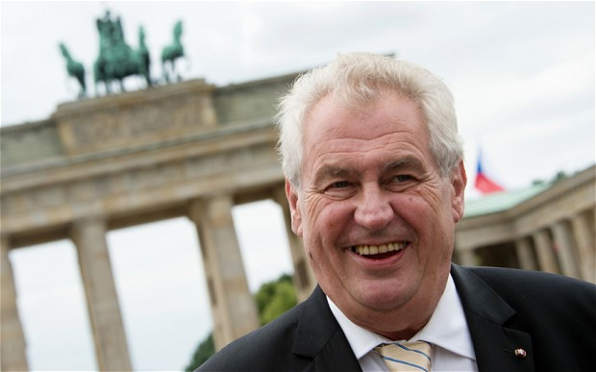
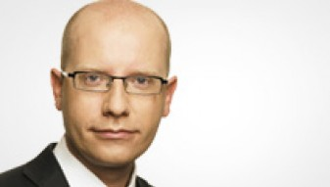
Political system: paliamanetary republic
President: Milos Zeman
Prime Minister: Bohuslav Sobotka

Slide 22
EU member country since: 1 May 2004
Seats in the European Parliament: 21
Schengen area member? Yes, Schengen Area member since 21 December 2007
Presidency of the Council: The Czech Republic has held the revolving presidency once in 2009

Slide 23
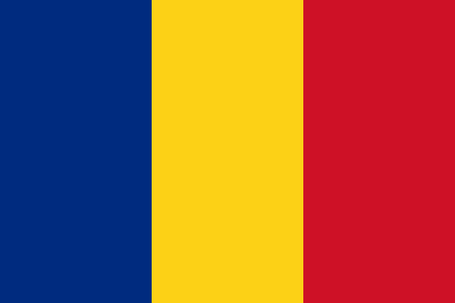
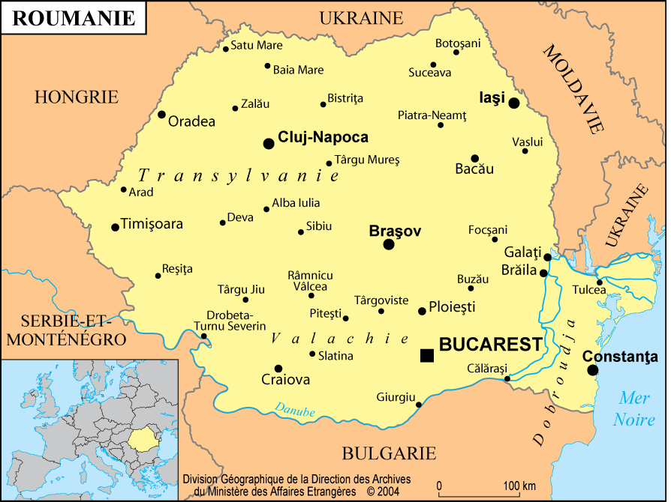
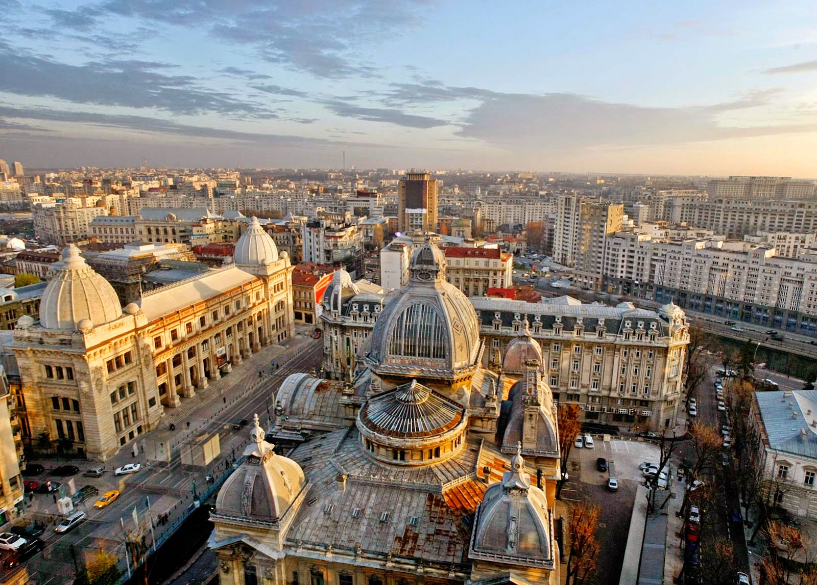
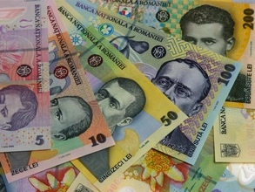
Romania
Geographical size: 238 390,7 km²
Capital: Bucharest
Currency: Romanian Leu RON
Population: 19 942 642
Population as % of total EU population: 32 %
Official EU language: Romanian

Slide 24


Political system: semi-presidential republic
President: Klaus Iohannis
Prime Minister: Victor Ponta

Slide 25
EU member country since: 1 January 2007
Seats in the European Parliament: 32
Schengen area member? No, Romania is not a member of the Schengen Area.
Presidency of the Council: Romania will hold the revolving presidency of the Council of the EU for the first time in 2019

Slide 26



Slovenia
Geographical size: 20 273 km²
Capital: Ljubljana
Currency: Eurozone member since 1 January 2007
Population: 2 061 085
Population as % of total EU population: 0,4%
Official EU language : Slovenian

Slide 27


Political system: semi-presidential republic
President: Borut Pahor
Prime Minister: Miro Cerar

Slide 28
EU member country since: 1 May 2004
Seats in the European Parliament: 8
Schengen area member? Yes, Schengen Area member since 21 December 2007
Presidency of the Council: Slovenia has held the revolving presidency of the Council of the EU once in 2008.

Slide 29



Slovakia
Geographical size: 49 036km²
Capital: Bratislava
Currency: Eurozone member since 1 January 2009
Population: 5 415 949
Population as % of total EU population: 1,1 %
Official EU language: Slovak

Slide 30


Political system: parliamentary republic
President: Andrej Kiska
Prime Minister: Robert Fico

Slide 31
EU member country since: 1 May 2004
Seats in the European Parliament: 13
Schengen area member? Yes, Schengen Area member since 21 December 2007
Presidency of the Council: Slovakia will holds the revolving presidency of the Council of the EU for the first time in 2016

