Slide 1
Country of North Europa:
-Netherlands
-Belgium
-Sweden
-Luxemburg
-Finland
-Denmark

Slide 2
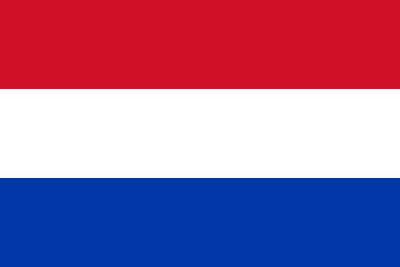
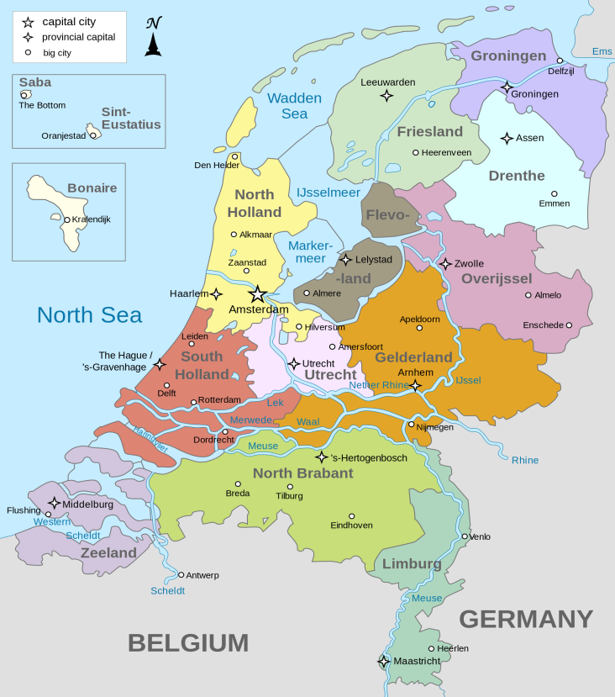
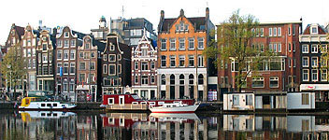
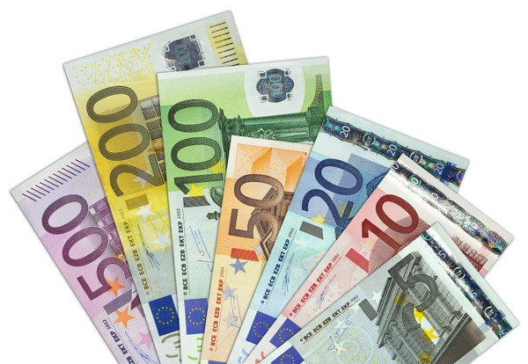
Netherlands
Geographical size: 41540 km²
Capital: Amsterdam
Currency: Euro
Population: 17 million
Population as % of total EU population: 3,3%
Official EU language: Dutch/English

Slide 3
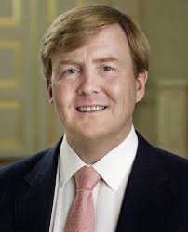
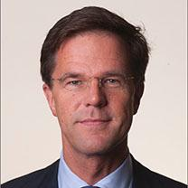
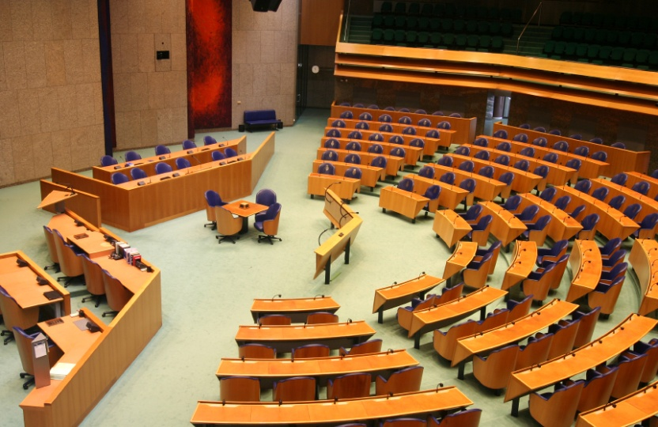
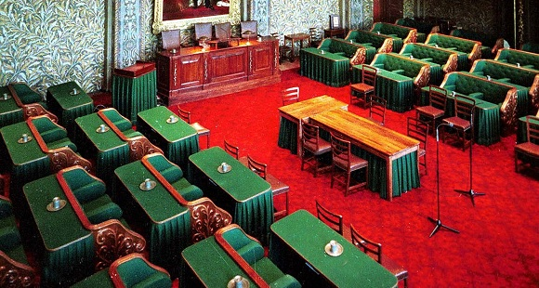
Political system: : Unitary parliamentary constitutional monarchy
Monarch: Willem-Alexander
Prime minister: Mark Rutte
Senat: Eerste Kamer
House of representatives:Tweede Kamer

Slide 4
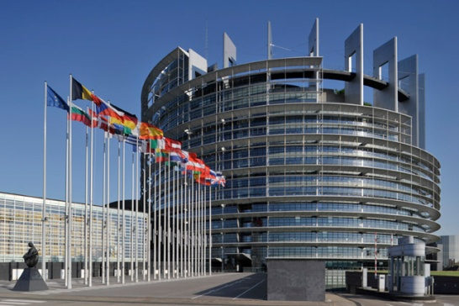
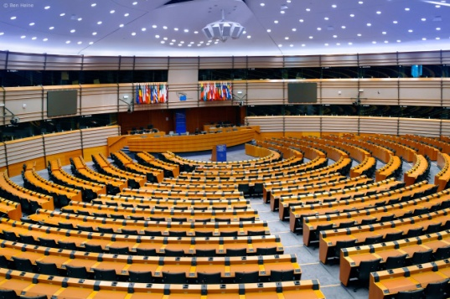
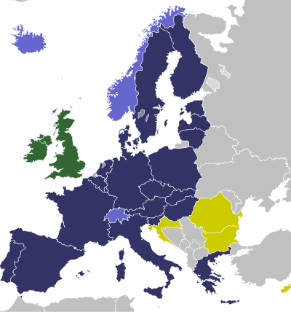
EU member country since: 1 January 1958
Seats in the European Parliament: 26
Schengen area member? Yes, Schengen Area member since 26 March 1995.
Presidency of the Council: Netherlands has held the revolving presidency of the Council of the EU 11 times between 1960 and 2004.

Slide 5
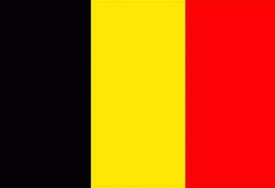
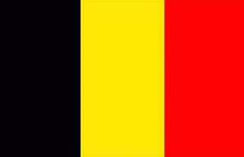
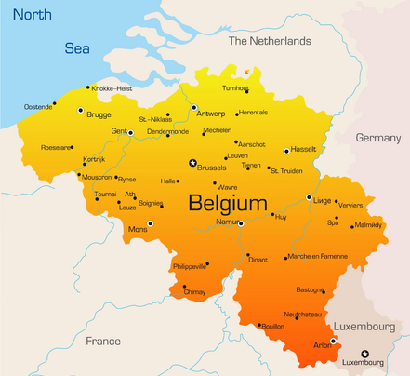
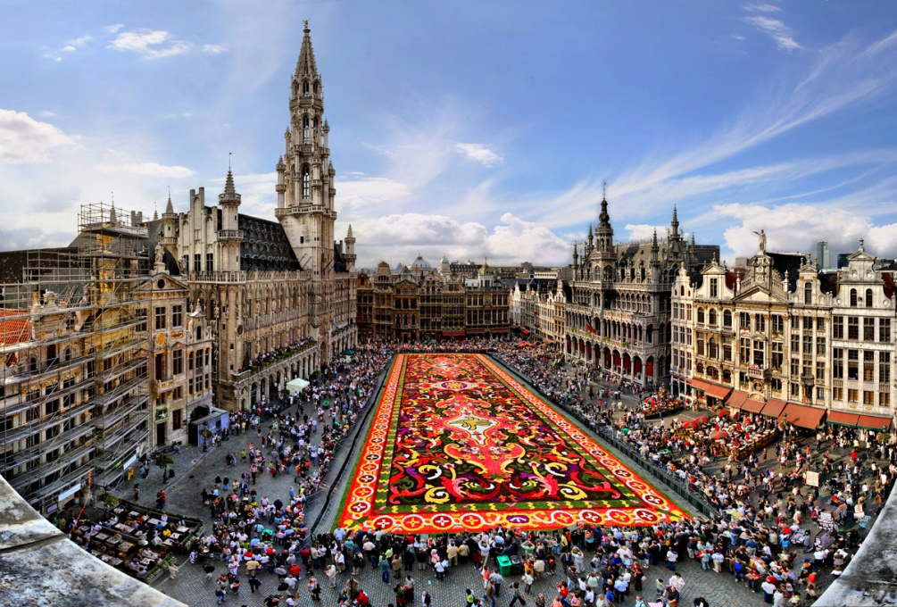
Belgium
Geographical size: 30 528,km²
Capital: Brussels
Currency: Euro
Population: 11.2 million
Population as % of total EU population: 2,2 %
Official EU language: Dutch/French/English

Slide 6
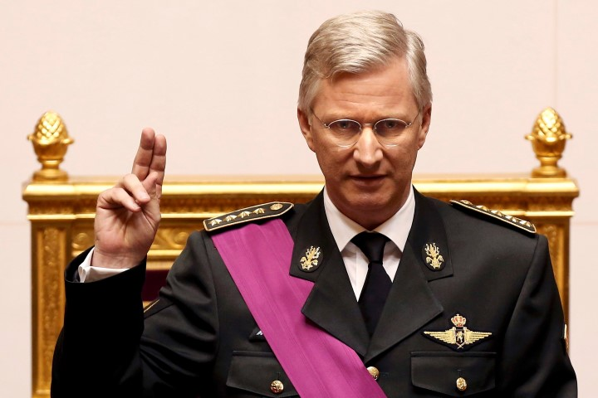
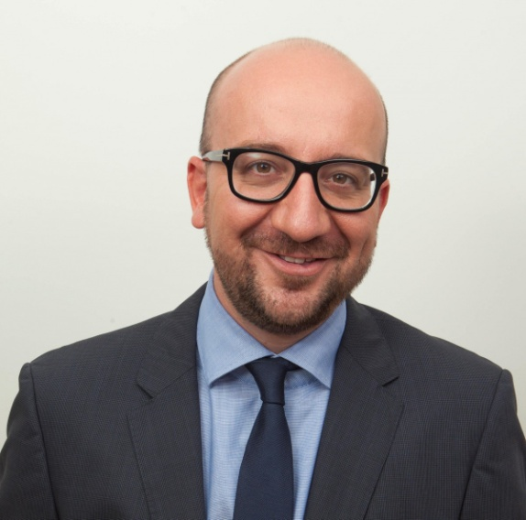
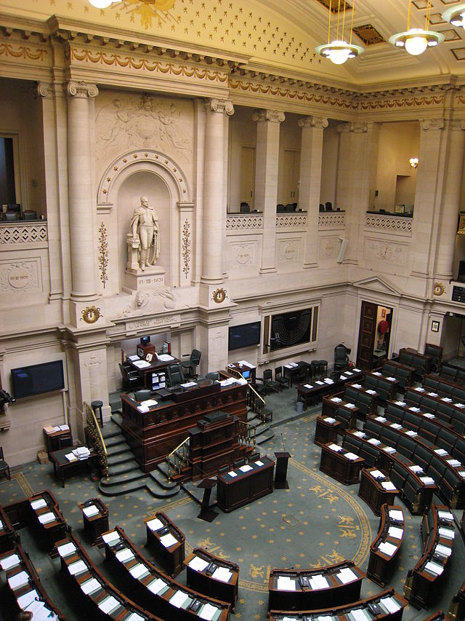
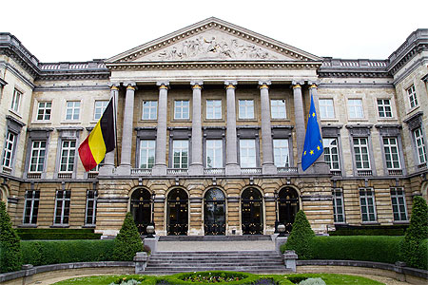
Political system: Federal parliamentary constitutional monarchy
King: Phillipe of Belgium
Prime minister: Charles Michel
Legislature: Parliament
Lower house: Chambers of representants
Upper house: Parliament Senate

Slide 7
EU member state since: 1 January 1958
Seats in the European Parliament: 21
Schengen area member? Yes, Schengen Area member since 26 Mars 1995.
Presidency of the Council: Belgium has held the revolving presidency of the council of the EU 12 times between 1958 and 2010.

Slide 8
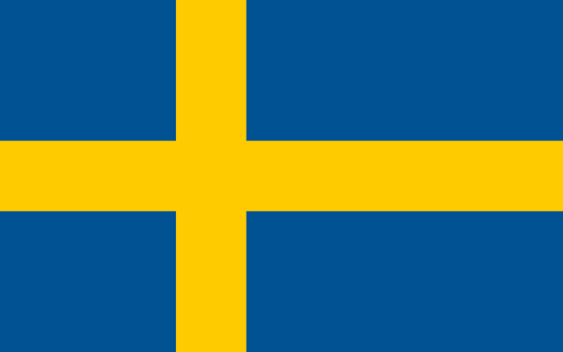
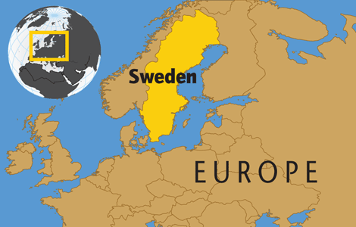
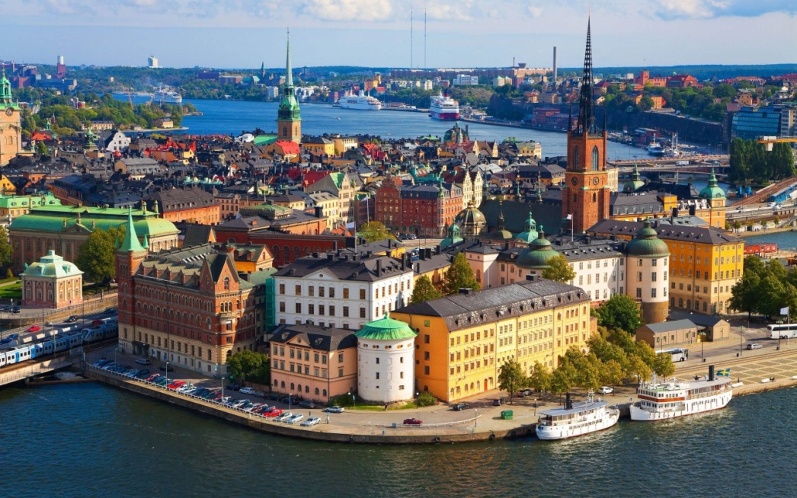
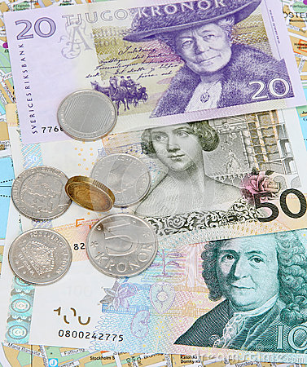
Sweden
Geographical size: 438 575,8 km²
Capital: Sockholm
Currency: Swedish Konna
Population: 9.6 million
Population as % of total EU population: 1.9 %
Official EU language: swedish

Slide 9
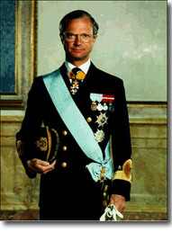
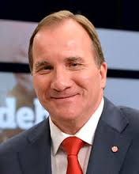
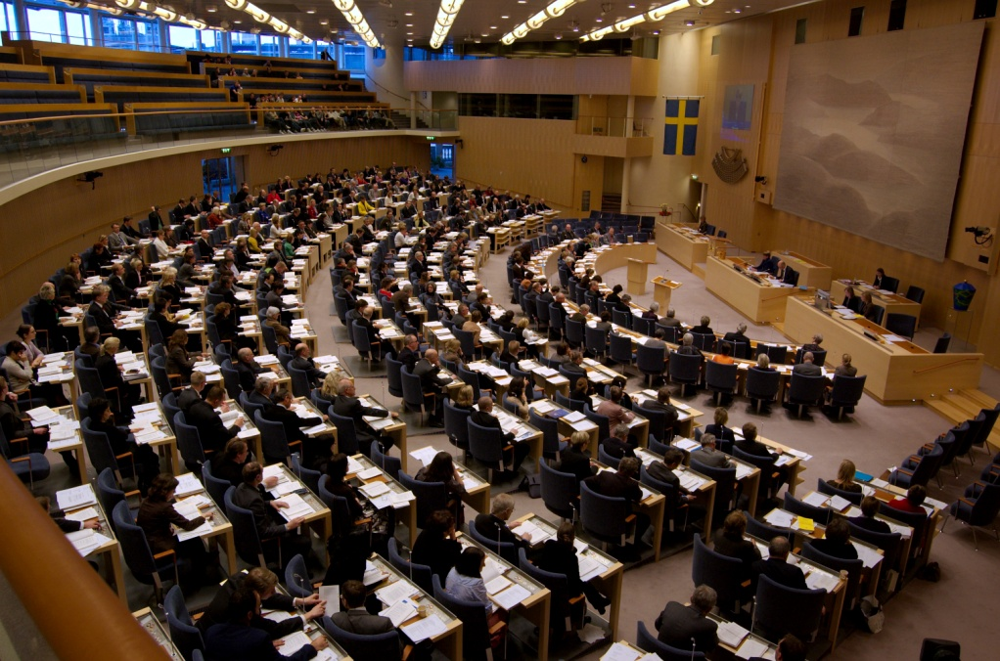
Political system: Unitary parliamentary constitutional monarchy
Monarch: Charles XVI Gustave
Prime minister: Stefan Lofven
Legislature: Riksdag

Slide 10
EU member country since: 1 January 1995
Seats in the European Parliament: 20
Schengen area member? Yes, Schengen Area member since 25 March 2001.
Presidency of the Council: Sweden has held the revolving presidency of the Council of the EU 2 times between 2001 and 2009.

Slide 11
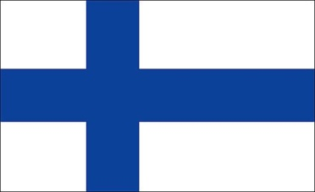
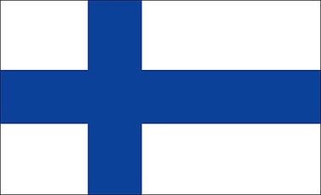
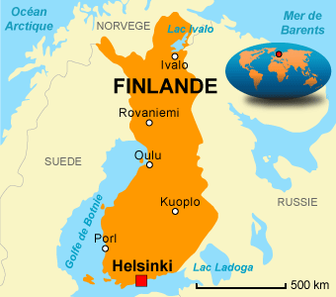
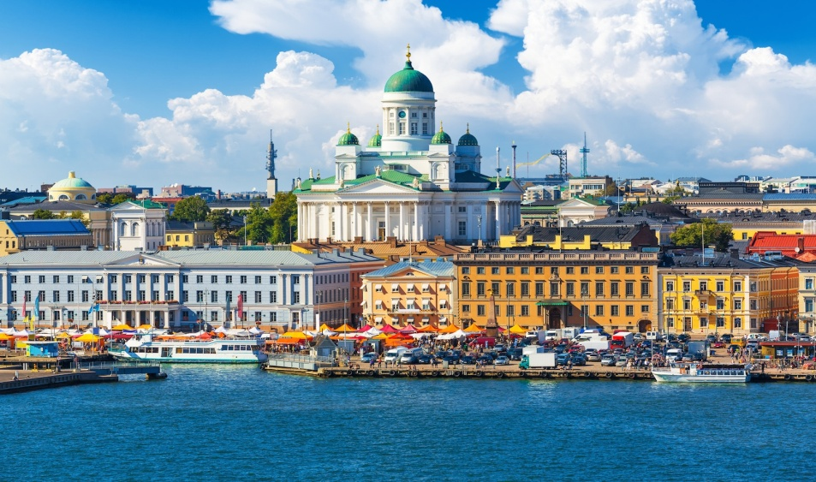
Finland:
Geographical size: 338 434.7km²
Capital: Helsinki
Currency: Eurozone member since 1 January 1999
Population: 5.5 millions
Population as % of total EU population: 1.1 %
Official EU language: Finnish

Slide 12
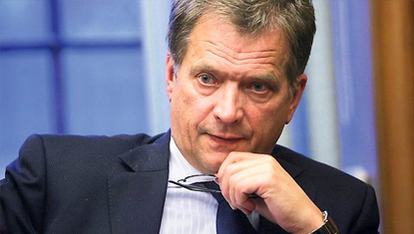
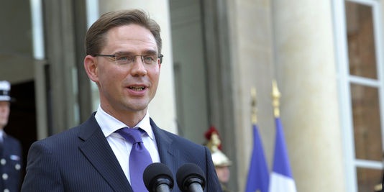
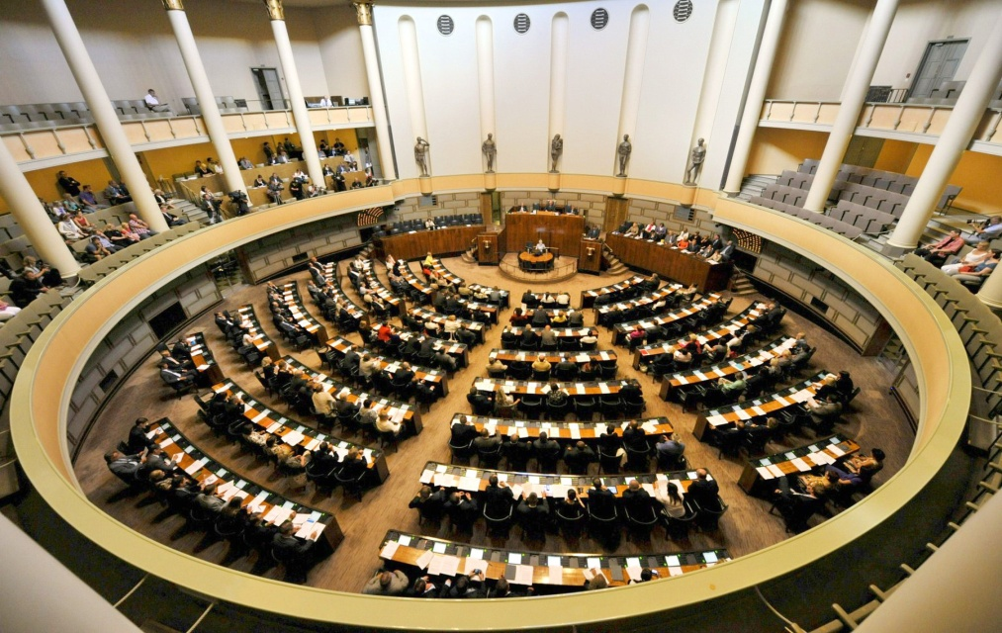
Political system: Parliamentary republic
President: Sauli Niinistö
Prime Minister:Alexander Stubb
Parliament: Eduskunta

Slide 13
EU member country since: 1 january 1999
Seats in the European Parliament: 13
Schengen area member? Yes, Schengen Area member since 25 March 2001.
Presidency of the Council: Finland has held the revolving presidency of the Council of the 2 times between 1999 and 2006.

Slide 14
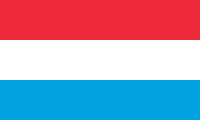
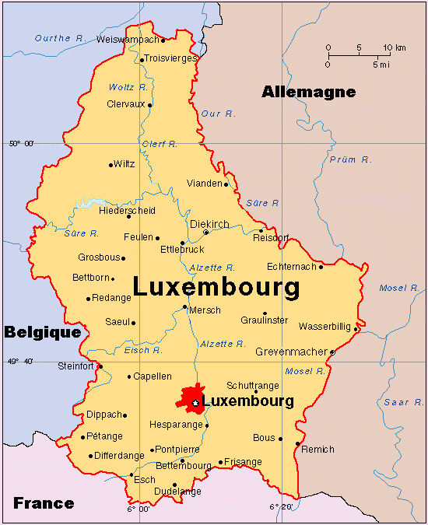
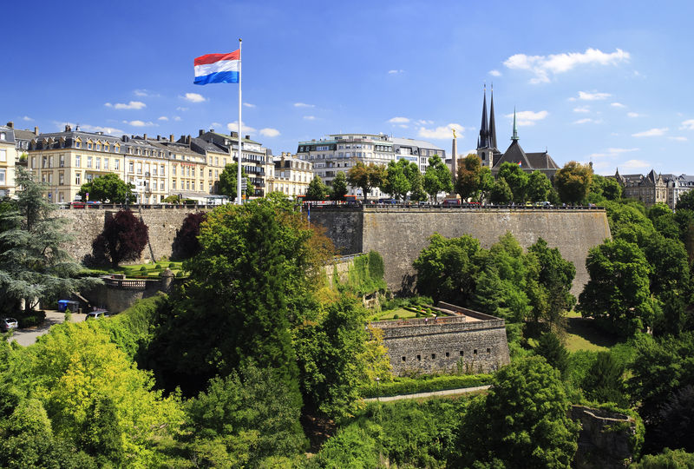
Luxemburg:
Geographical size: 2586 km²
Capital: Luxemburg
Currency: Eurozone member since 1 January 1999
Population: 0.5 millions
Population as % of total EU population: 0.1 %
Official EU language: French, Deutsch

Slide 15
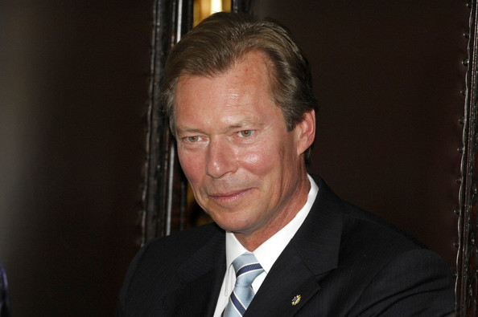
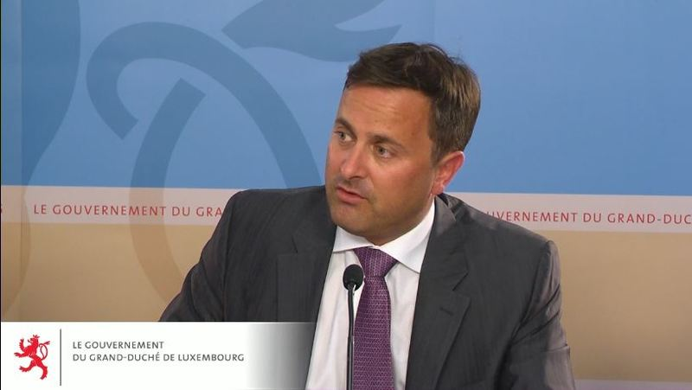
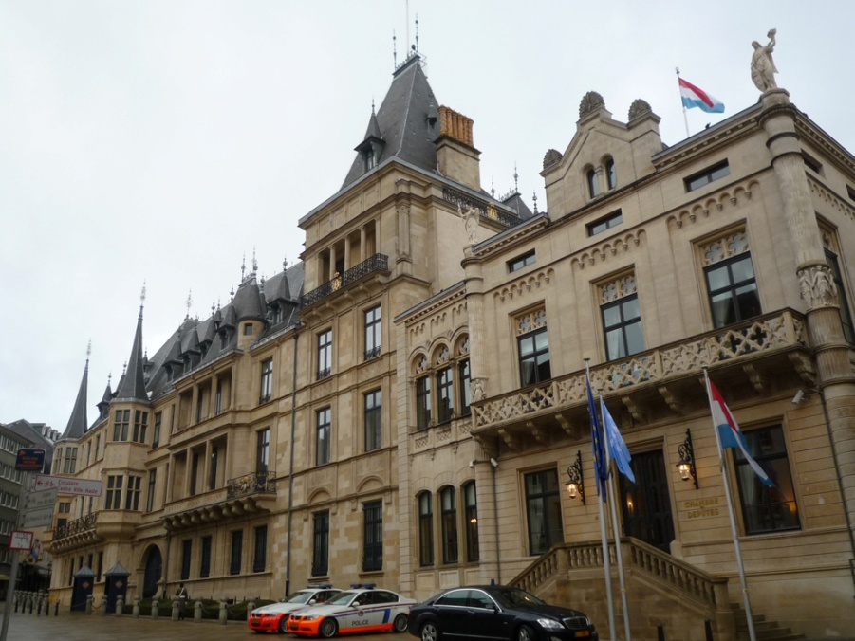
Political system: Unitary parliamentary constitutional monarchy
Monarch: Henri
Prime Minister: Xavier Bettel
Parliament: Chamber of Deputies

Slide 16
EU member country since: 1 january 1999
Seats in the European Parliament: 6
Schengen area member? Yes, Schengen Area member since 26 March 1995.
Presidency of the Council: Luxemburg has held the revolving presidency of the Council of the 11 times between 1960 and 2005.

Slide 17
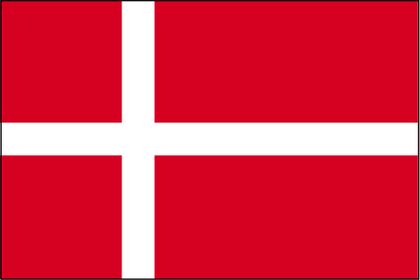
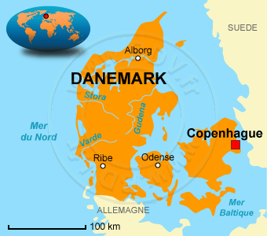
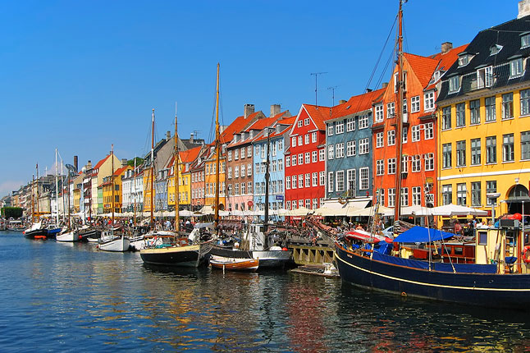
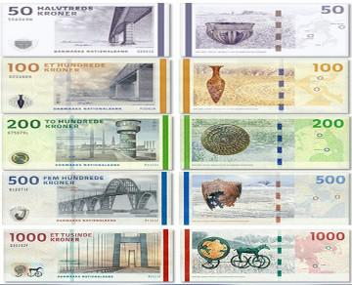
Denmark:
Geographical size: 42 915 km²
Capital: Copenhaguen
Currency: Danish Krone
Population: 5.6 millions
Population as % of total EU population: 1.1 %
Official EU language: Danish

Slide 18
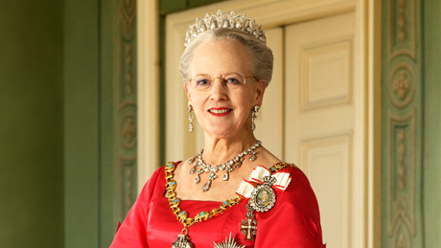
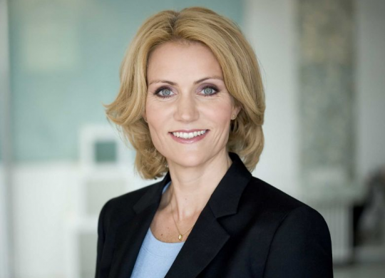
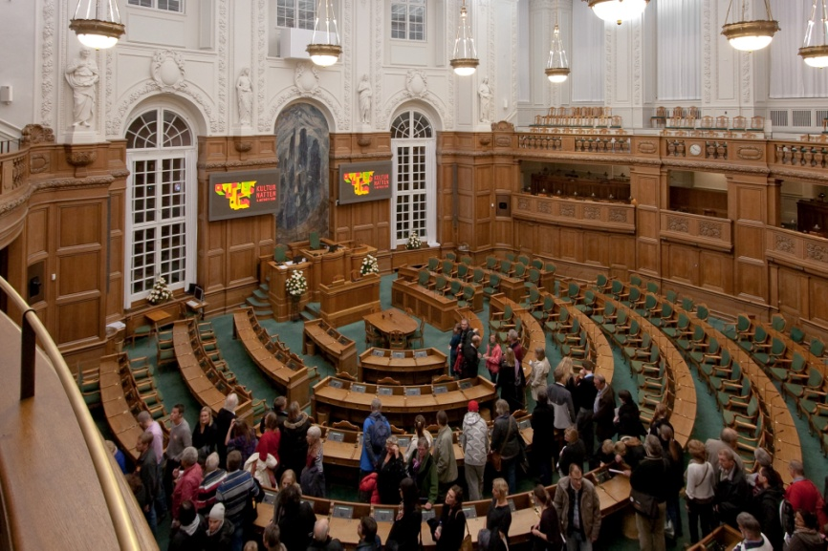
Political system: Unitary parliamentary constitutional monarchy
Monarch: Margrethe II
Prime Minister: Helle Thorning-Schmidt
Parliament: The Folketing

Slide 19
EU member country since: 1 january 1973
Seats in the European Parliament: 13
Schengen area member? Yes, Schengen Area member since 25 March 2001.
Presidency of the Council: Denmark has held the revolving presidency of the Council of the 7 times between 1973 and 2012.

