Slide 1
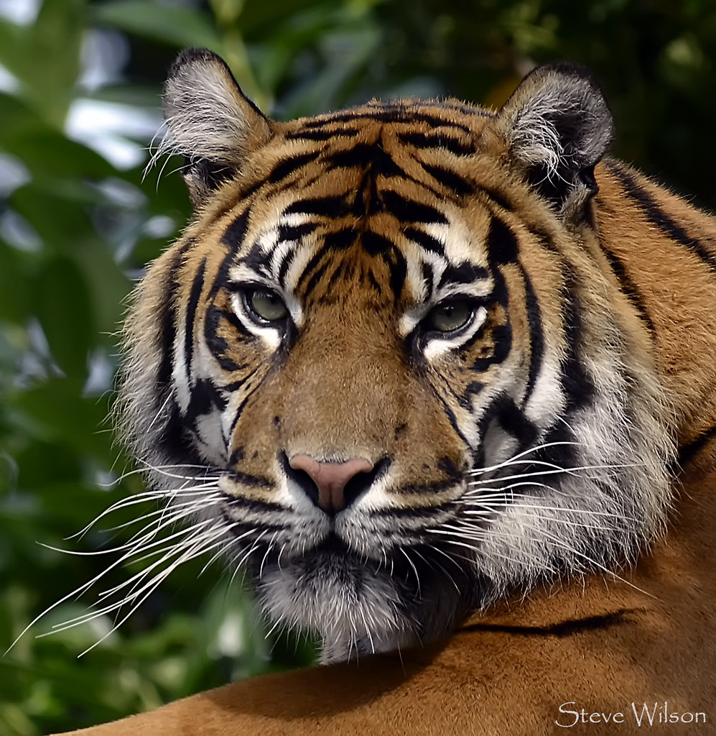
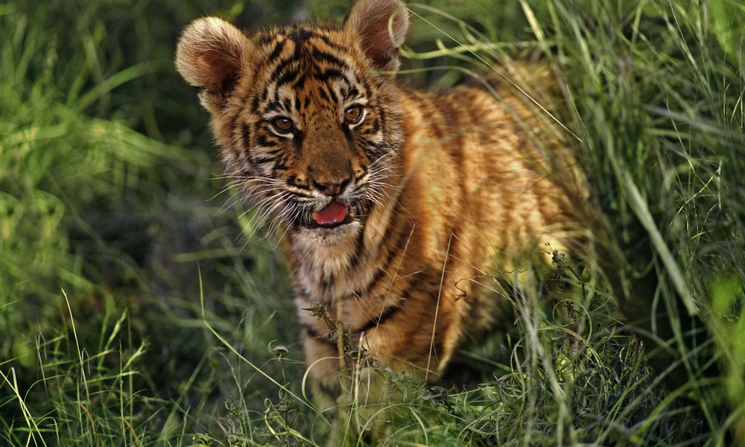
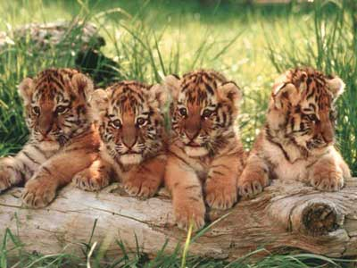
The Sumatra Tiger
Bernard Ynes & Chirol Lila

Slide 2
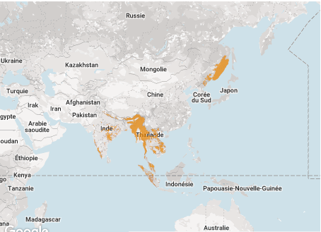
Where do they live ?
They live in Sumatra ,Thailande, India and southeast Asia.
Southeast Asia
India
Sumatra
Thaïlande

Slide 3
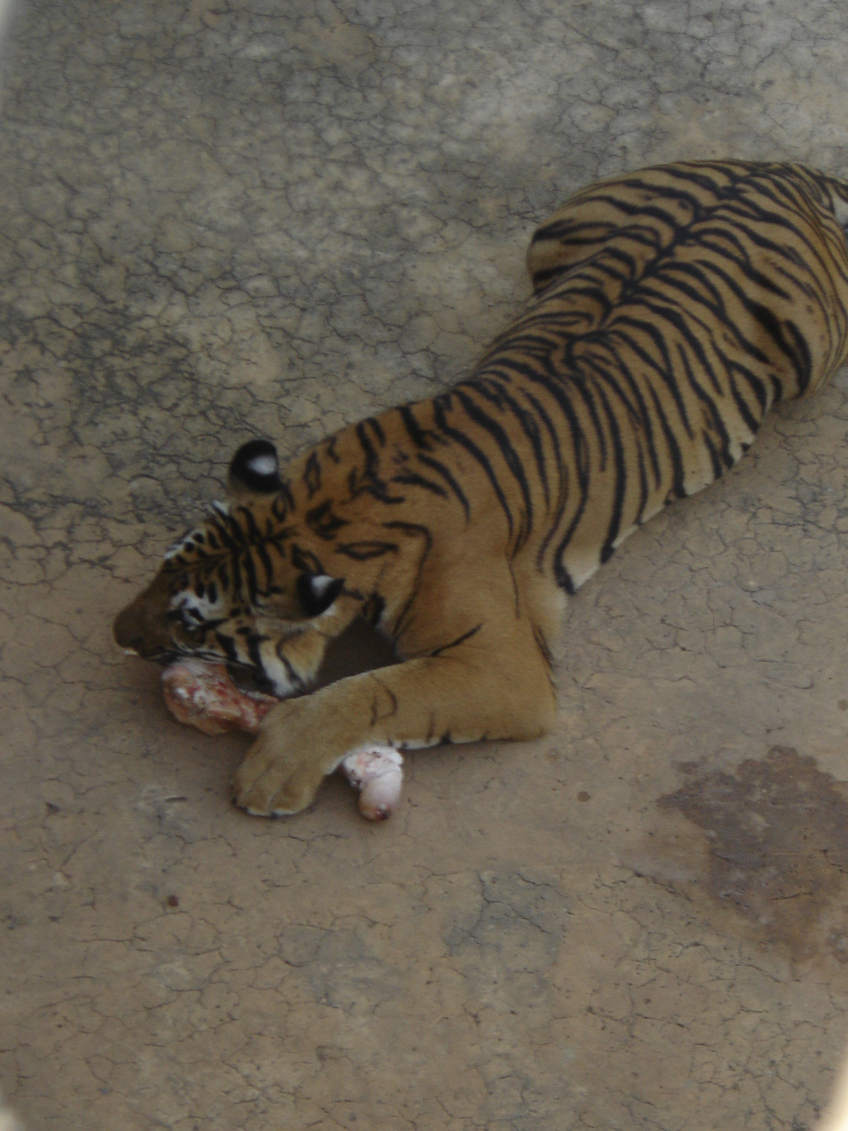
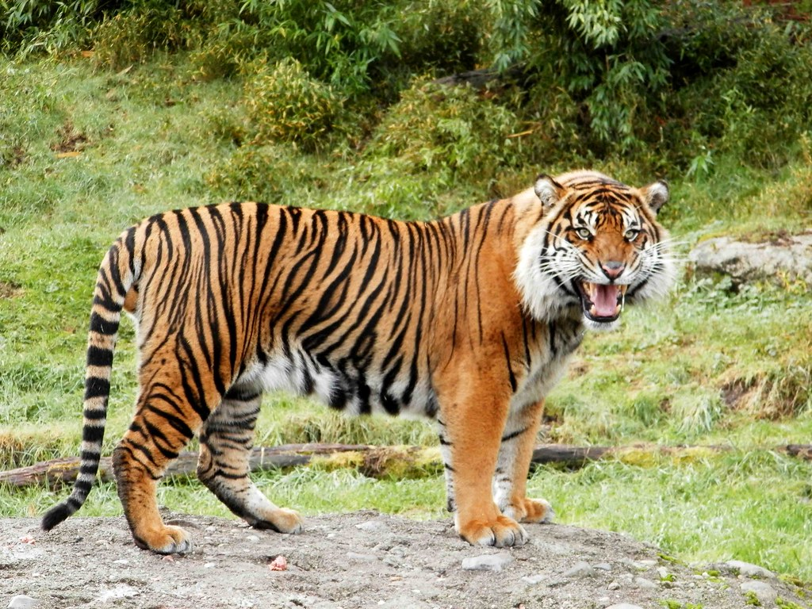
Description
Tigers eat 40kg of meats .
They can mesure 2m to 3m long.
They can weight 100kg to 300kg.
They can live 20 years and they are mostly solitary.
2m to 3m (adults)
meat
100kg to 300kg

Slide 4
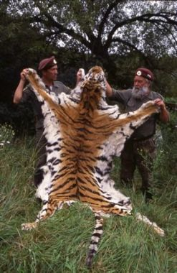
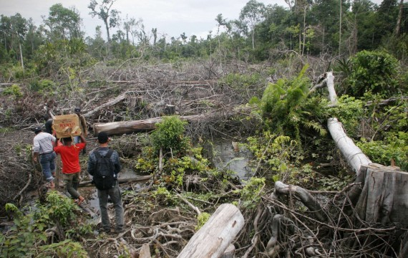
Reasons why they are endangered :
They are killed by hunters.
Their habitat are destroyed by human activity .
Hunters

Slide 5
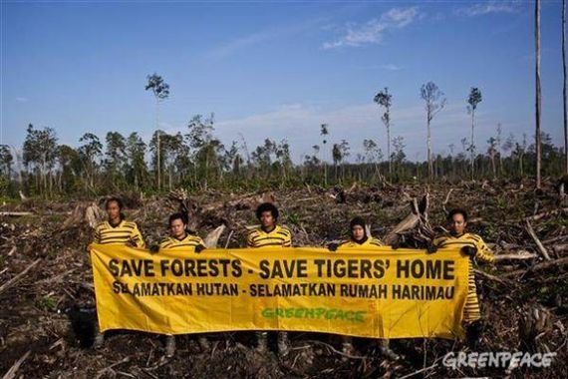
SAVE FORESTS – SAVE TIGERS

