Slide 1
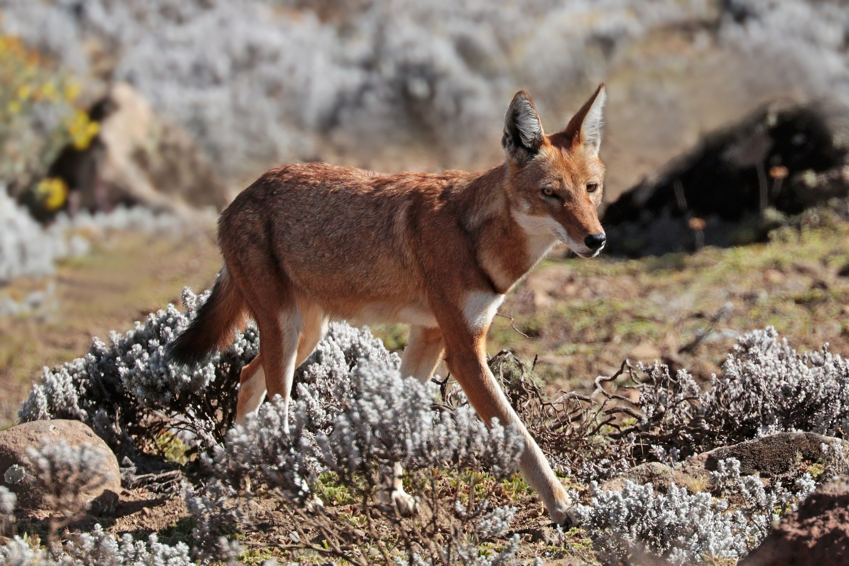
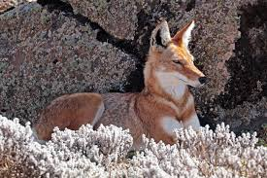
The Ethiopian Wolf
Samuel,William,Kamel

Slide 2
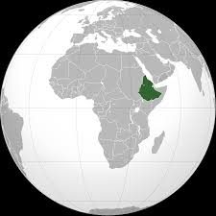

It comes from Ethiopia

Slide 3
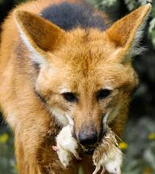
It is a carnivor

Slide 4
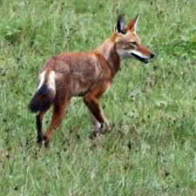
The size of a Ethiopian Wolf Is 66-81cm adult

Slide 5
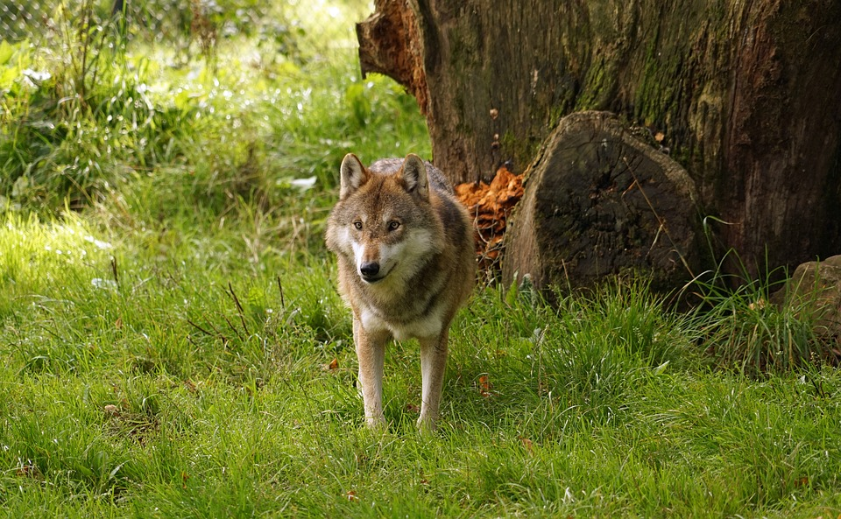
It can weight 14kg (adult)

Slide 6
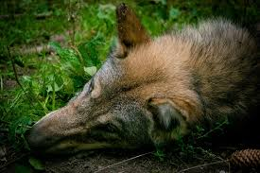
The ethiopian wolf is hunted for its fur, the wolf is in the process of disappearing ,So You must stop hunting It.

