Slide 1
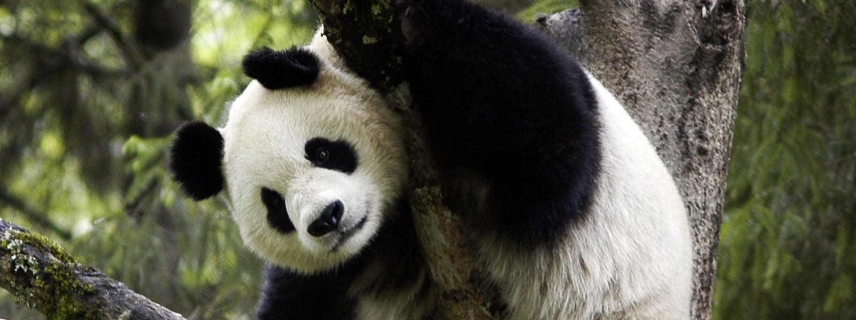
THE GIANT PANDA
SOMMAIRE:
1-where is the natural habitat
2-what we eat
3-physical information
4-reasons why they are endangered

Slide 2

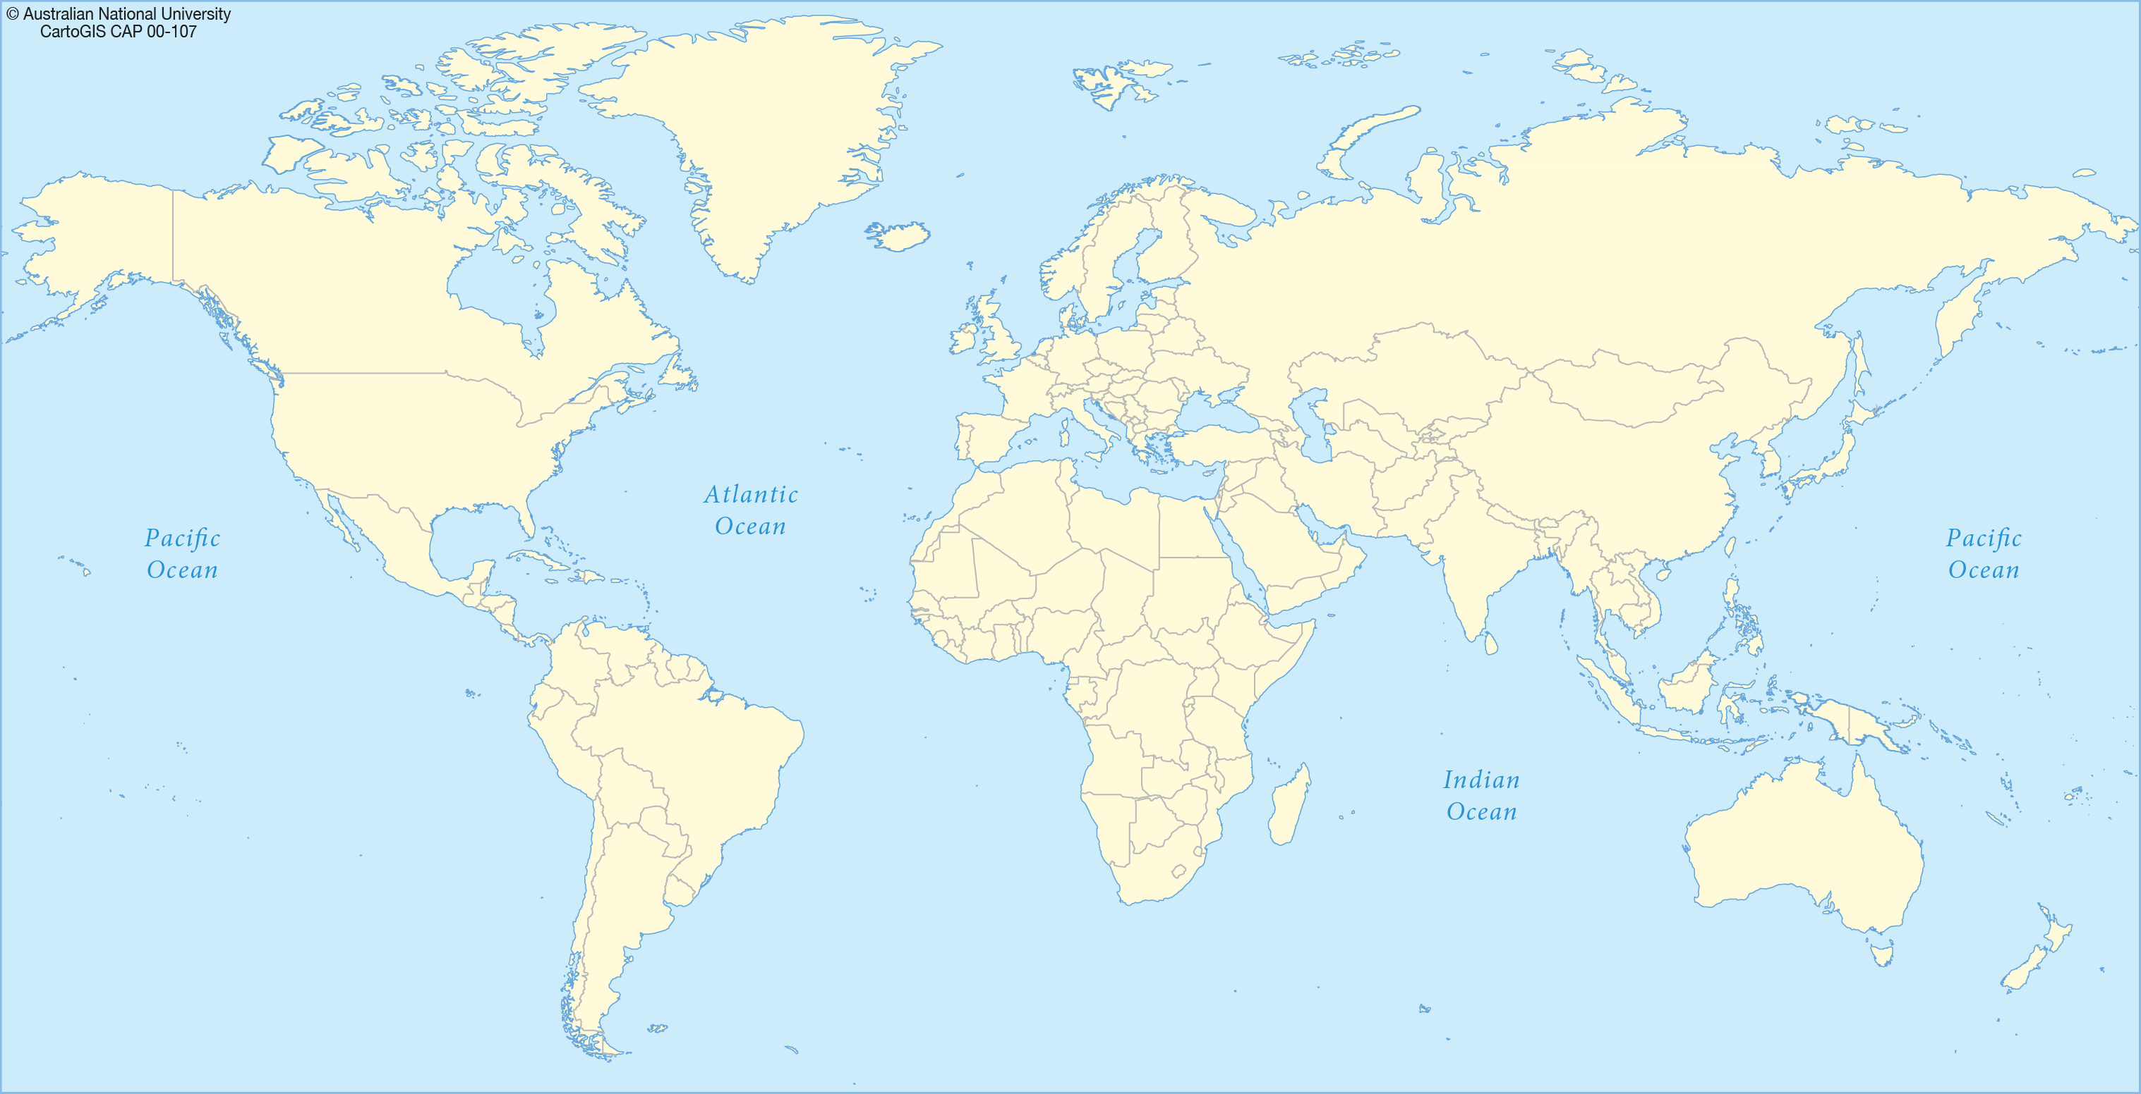
WHERE IS THE NATURAL HABITAT ?
The natural habitat of the giant panda is bamboos forest of south west of the China
the giant panda is also found in zoo and parks protect

Slide 3
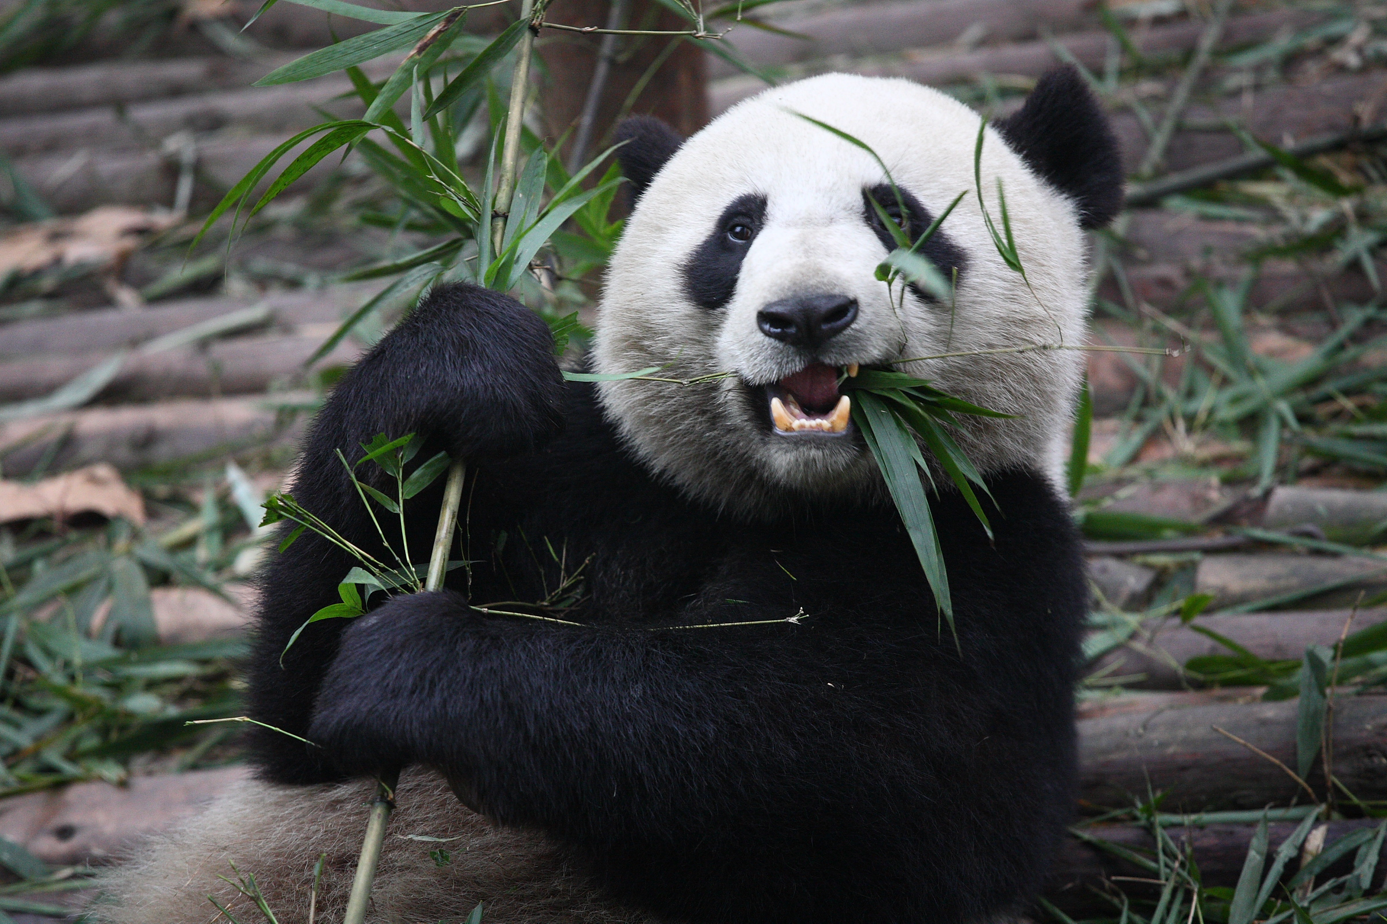
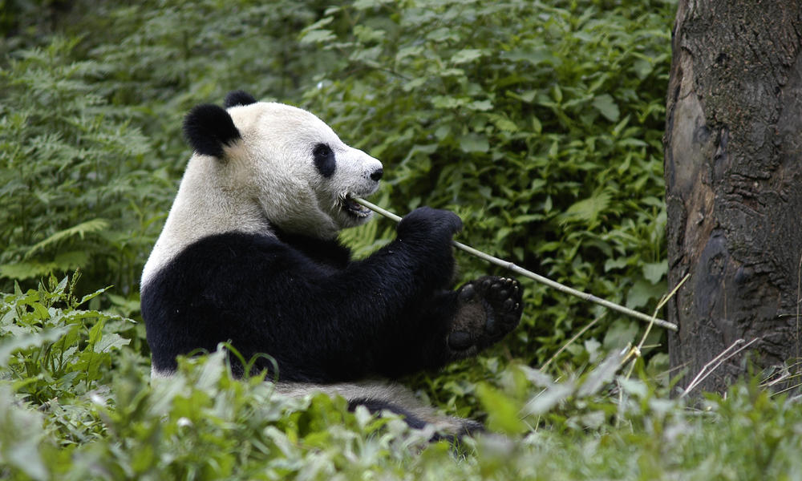
What does it eat ?
The giant panda .
It is herbivore.

Slide 4
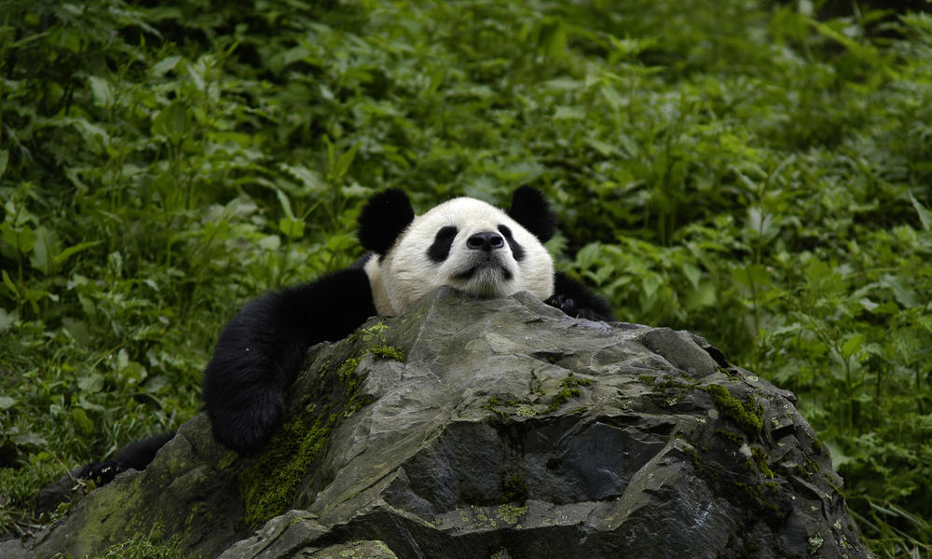
Physical information :
It is about 60 TO 90 CM TALL
It IS ABOUT 1,2 TO 1,9 METERS LONG

Slide 5
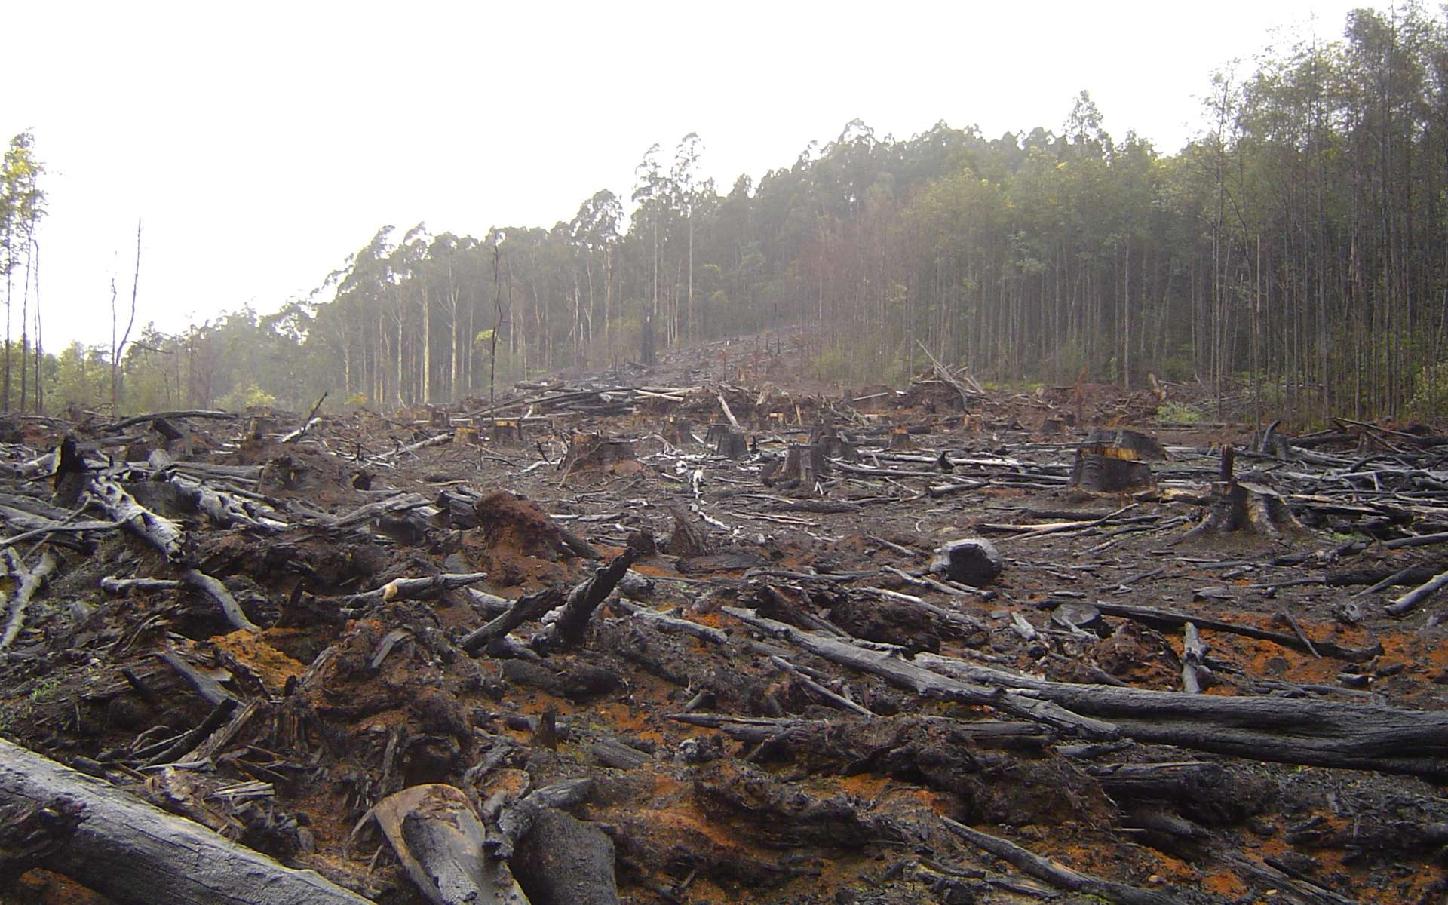
Reasons why they are endangered ?
THERE IS ENDANGERED BECAUSE HUMAN ACTIVITY DESTROY FOREST .

Slide 6
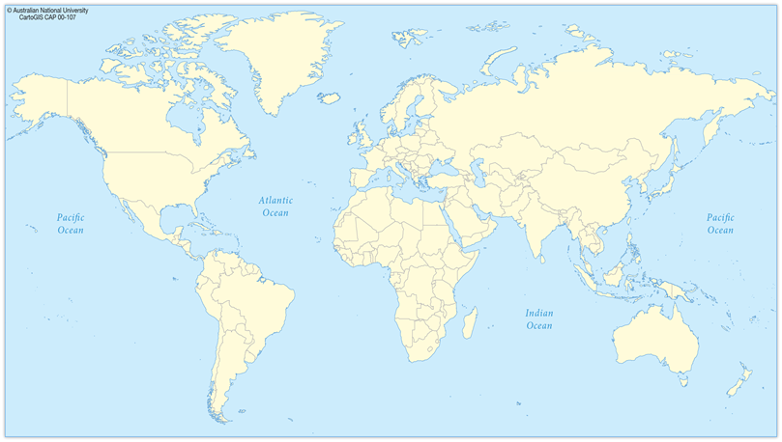
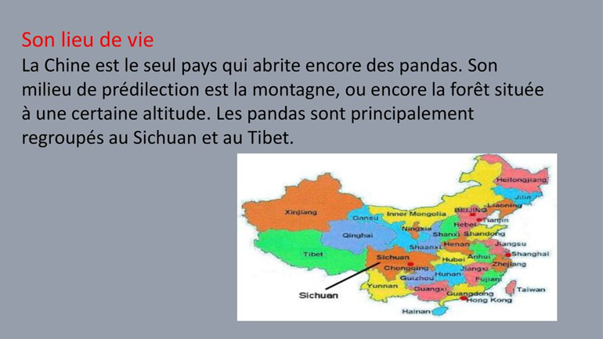
Pour ce qui n’ont rien compris .

