Slide 1
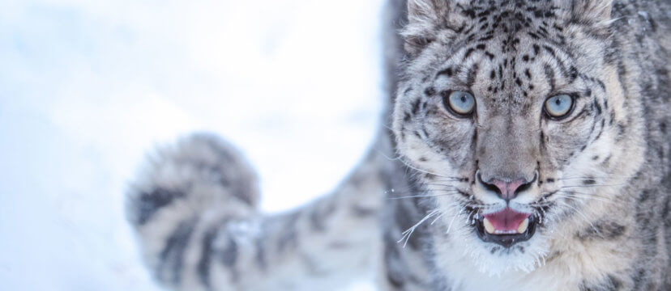
The snow leopard
Cordelia Dexter
Luciana Tui

Slide 2
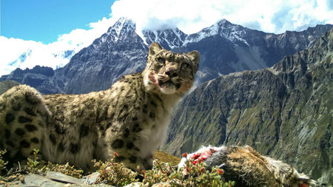
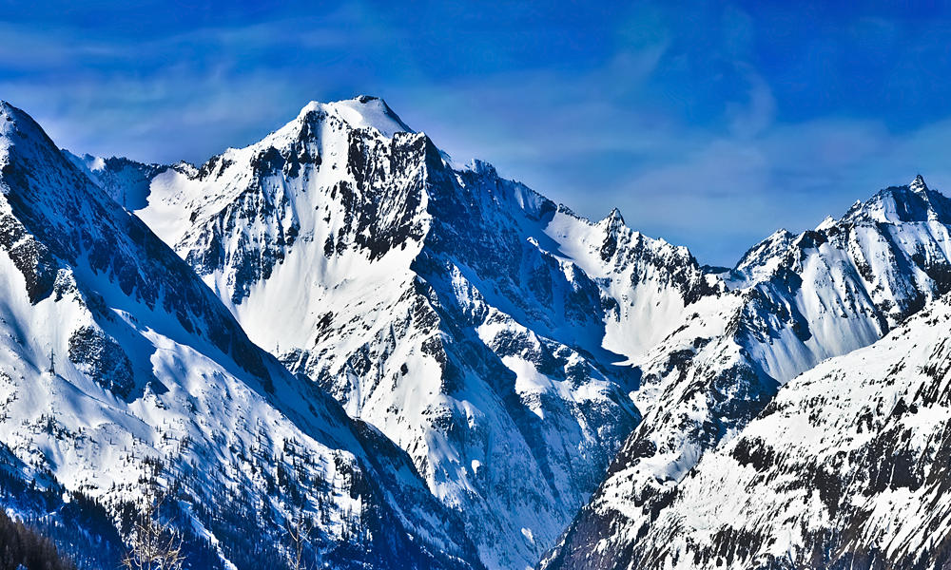
How is the snow leopard?
The snow leopard is a big cat from the mountain. It is carnivore

Slide 3
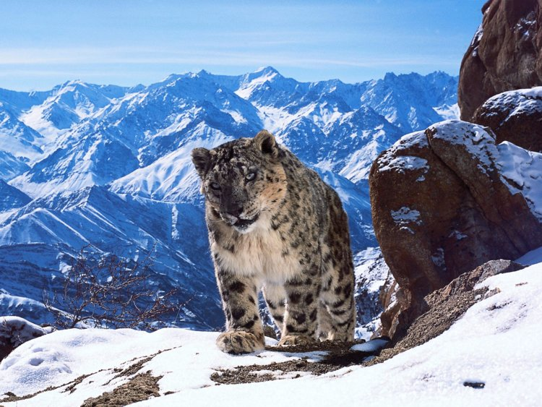
Why they are important? Snow leopards play a key role as superior predators and as indicators of habitat health at high altitudes.

Slide 4
Why are they on the way to disappearing?
The snow leopard are on the way to disappearing because the farmer kill them

