Slide 1

My trip in New Zealand
From October 23rd to November 22nd 2015
Lucas Robineau 503

Slide 2
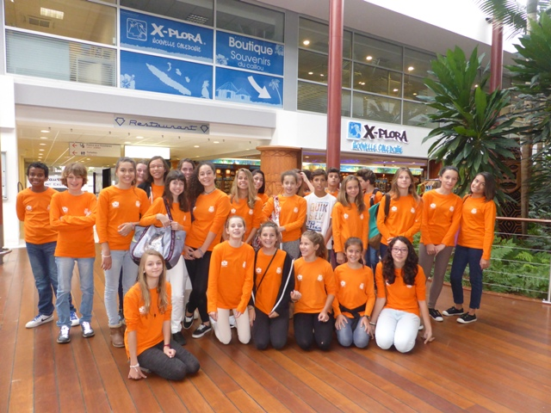
Departure from New Caledonia
The three future Kiwis

Slide 3
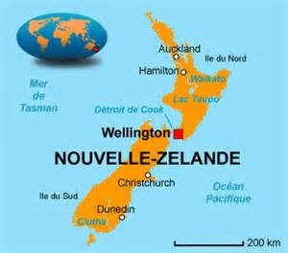
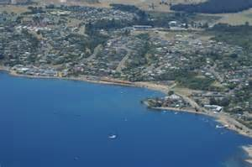
Taupo
Taupo
Taupo is a town situated in the North Island by a lake. There are around 27,500 inhabitants in Taupo.

Slide 4
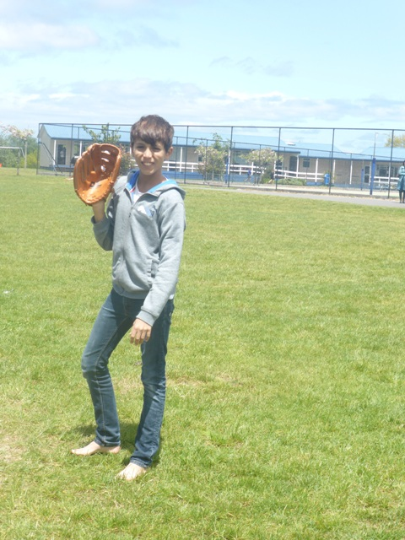
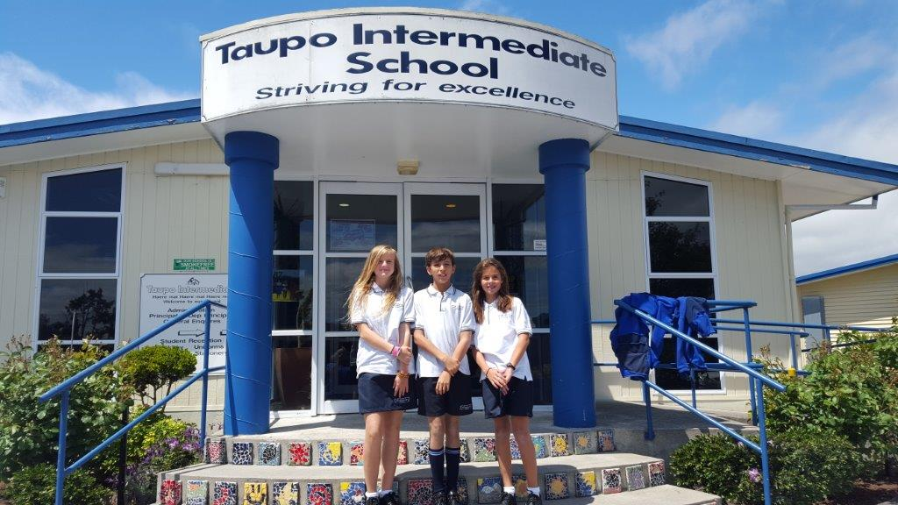
Taupo Intermediate School

Slide 5



The five new flags proposed for the referendum
The current flag

Slide 6
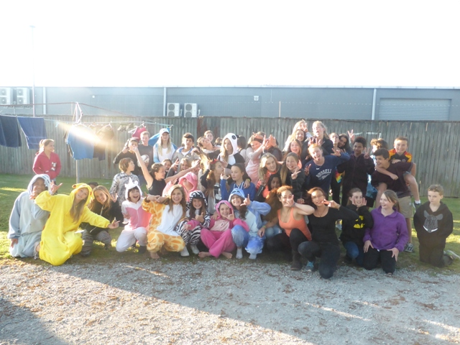
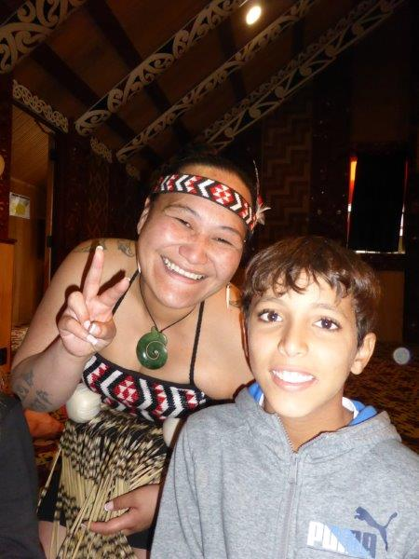
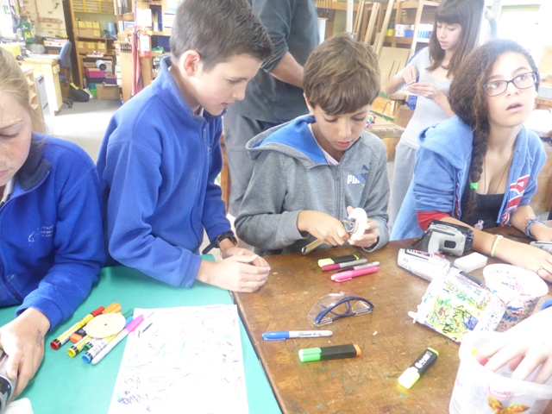
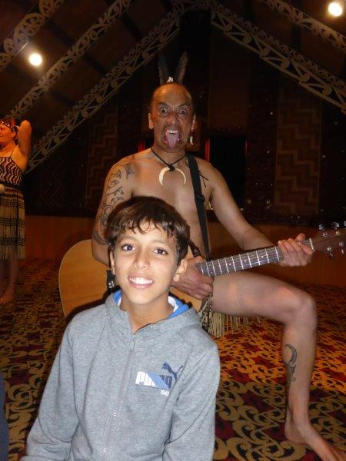
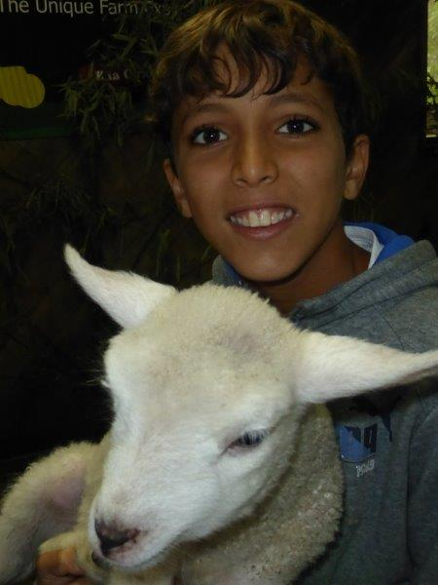
Photos

