Slide 1
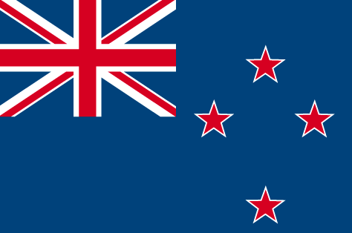
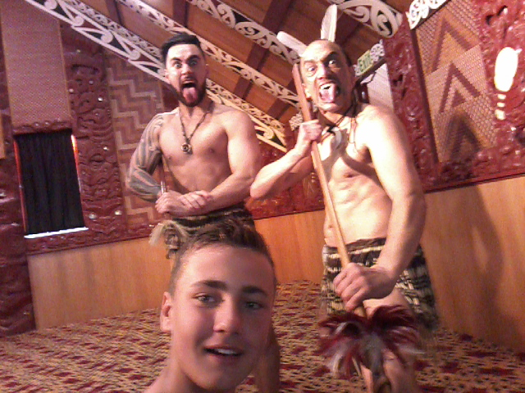

During my trip in Taupo, I discovered a lot of different aspects of the culture and of the population of New Zealand.
Culture, people, nature and language are so different from ours.
1

Slide 2
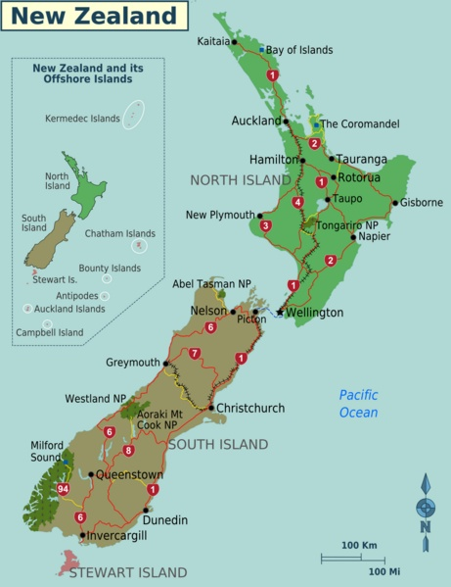
2

Slide 3
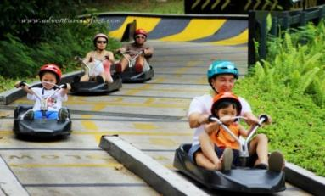
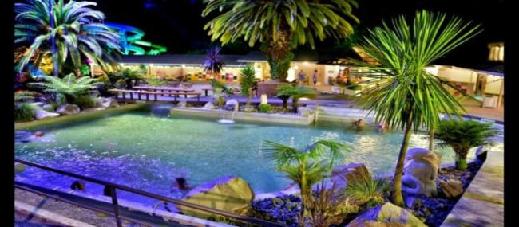
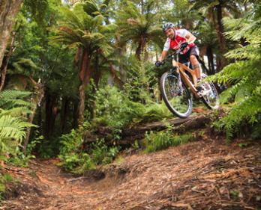
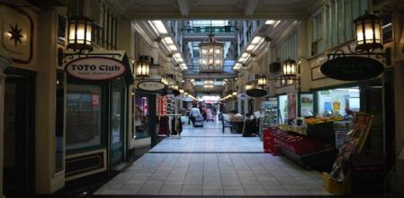
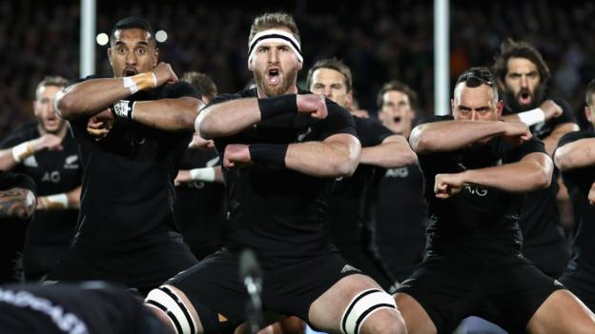
My activities in New Zealand
It was great !
In New Zealand, my activities were :
. mountain biking, . shopping, . swimming, . luge and rugby.
3

Slide 4
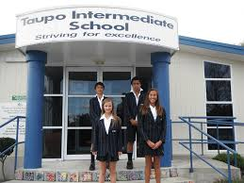

My New Zealand school
My New Zealand school’s name was Taupo Intermediate school. This school is very different from mine.
In this school, we can go barefoot and there is no school restaurant. Students take their lunch box. In New Zealand schools, students do not work as much as we do in New Caledonia. They start their lessons at 8H45am and they finish at 3pm.
In my billet’s school there were a lot of various sports proposed, more than in my own school. It was cool because they can play every sport and they can take a ball during school time.
4

Slide 5
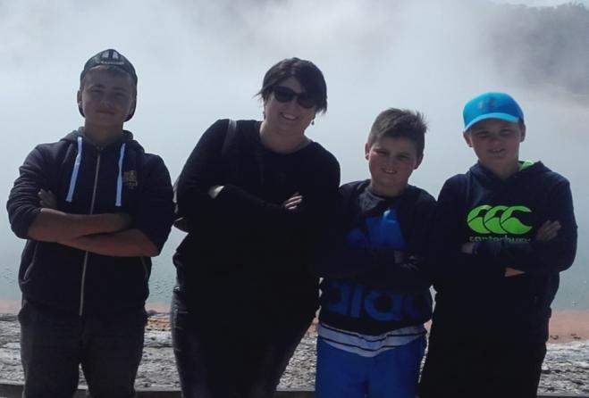
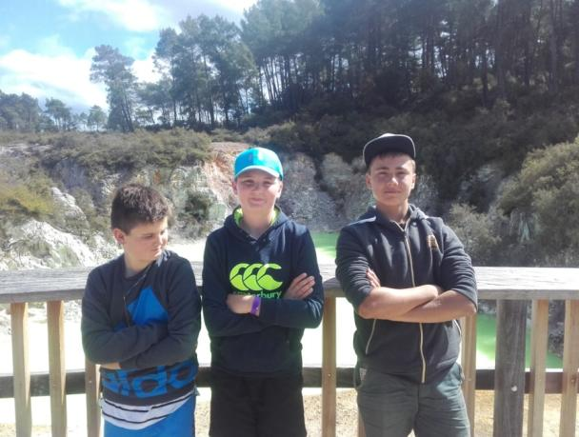
My life in the first family
In my first family, I lived on a farm.
This farm was cool because there was a lot of space and in New Caledonia I live in town and in a flat.
With my first family, we went to the lake on the boat. We also went shopping, mountain biking.
I was also lucky to play rugby because Jamie is a rugby player.
My first family was really friendly.
5

Slide 6
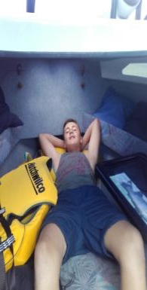
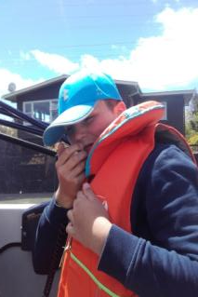
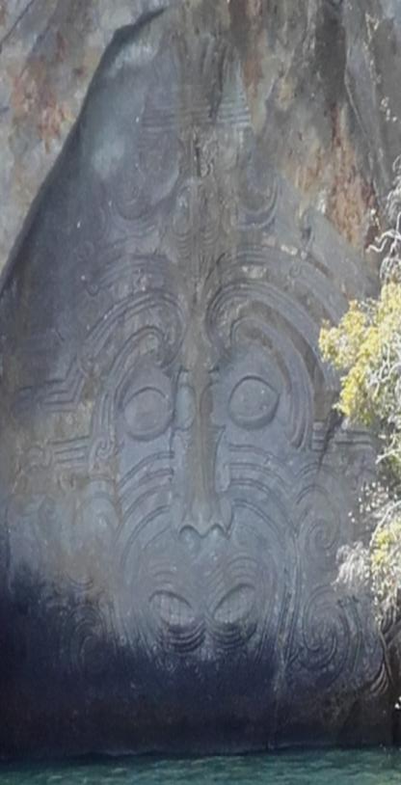
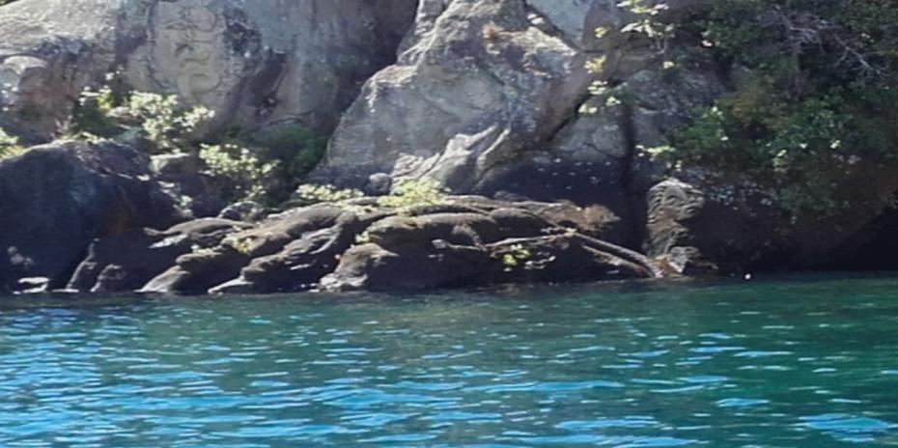
These are some photos from my boat trip on Taupo’s lake.
It was a great time shared with Jaimie’s family ! ☺
6

Slide 7
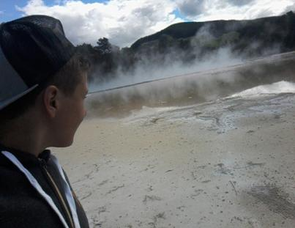
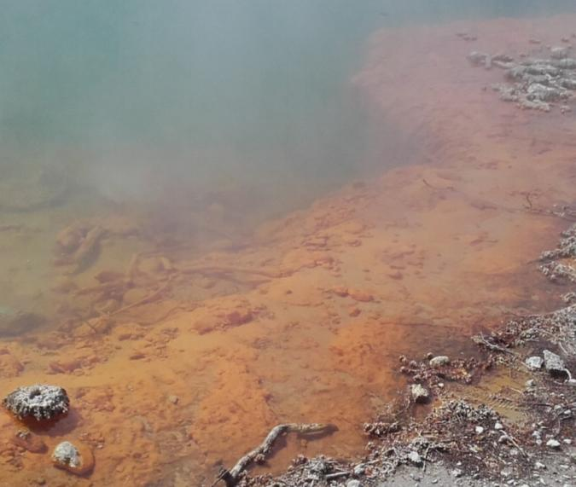
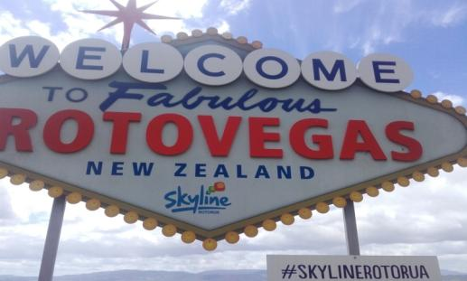
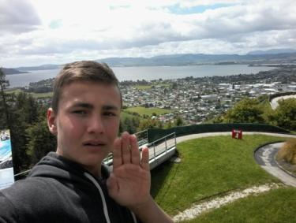
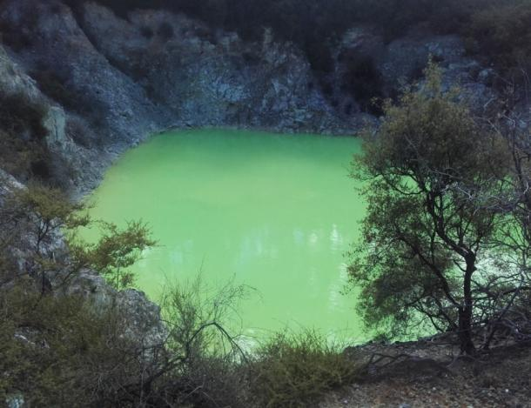
Rotorua is a very exceptional place : it’s wonderful but it smells very bad ! The smoke that comes from earth is the result of a volcanic system. I was very impressive !
7

Slide 8
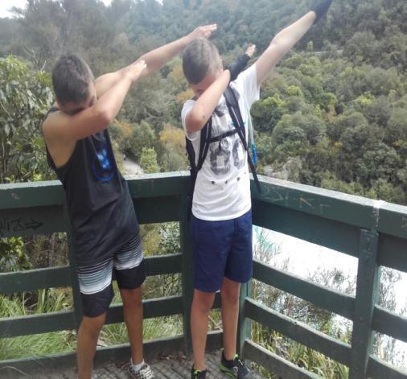
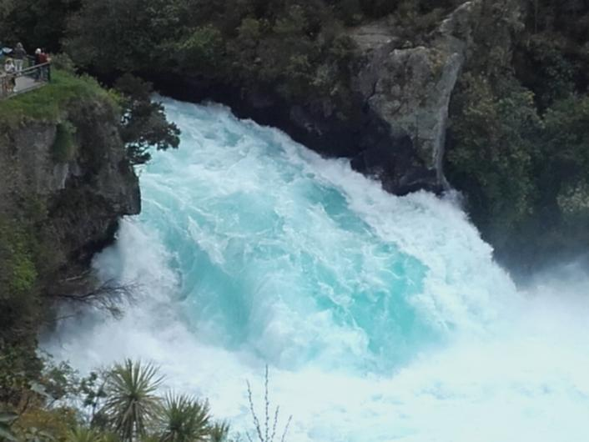
We went mountain biking with Jaime and his friend.
It was great!
When we went mountain biking, I saw the water fall.
It was so much fun and so beautiful !
8

Slide 9
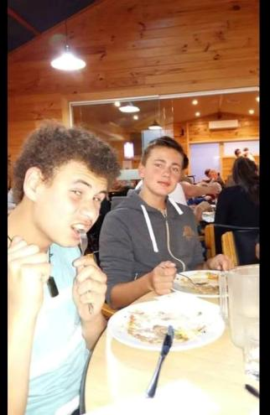
My second family
I spent more time in my second family than in the first one, because I wanted to stay longer in New Zealand. I love New Zealand.
My billet’s name was Taine.
Every day, I went with him at school in his classroom in order to improve my English.
My second stay was also really cool because I learnt a lot of English.
I also discovered many aspects of what a family life can be in New Zealand.

Slide 10
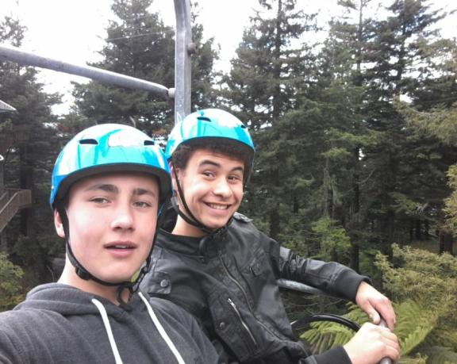
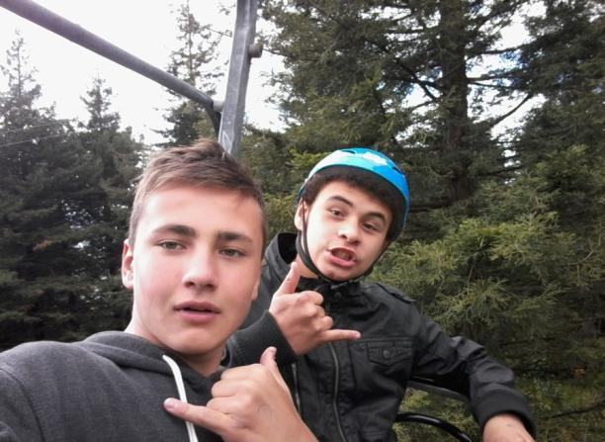
Taine’s parents brought us to Rotorua.
We did a very funny sport : Luge.
We went also biking in town with Taine’s friend and his brother.

Slide 11
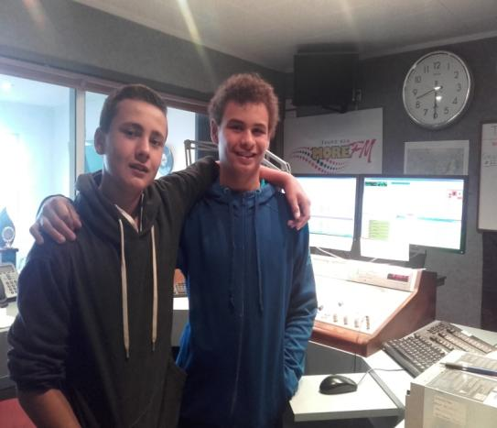
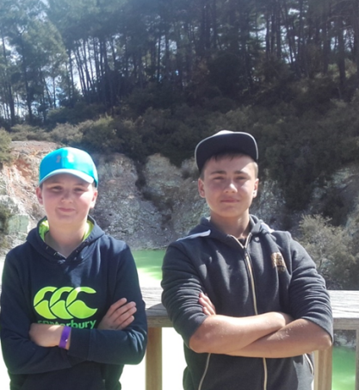
We also went to the radio station.
A journalist asked me questions about the reasons of my trip.
It was very cool !
THE END

