Slide 1


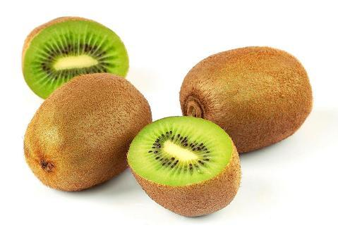
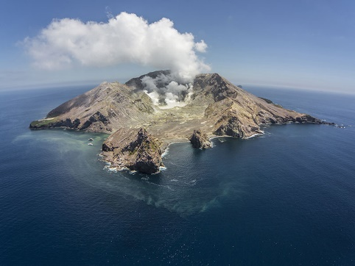
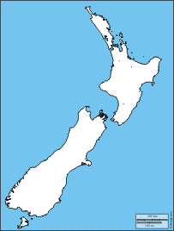
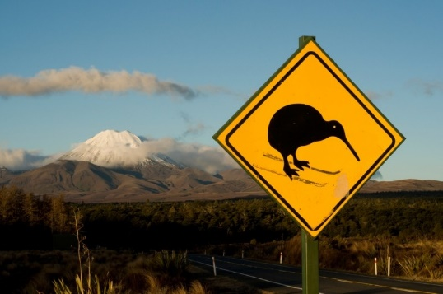
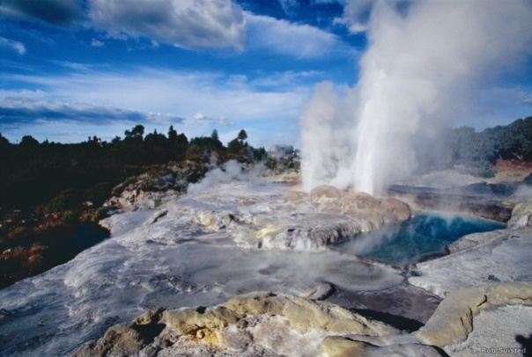
My trip in New Zealand

Slide 2
1/ New Zealand
2/ Schooling
3/ with my school

Slide 3
1/ New Zealand
2/ Schooling
3/ with my school

Slide 4


New Zealand

Slide 5
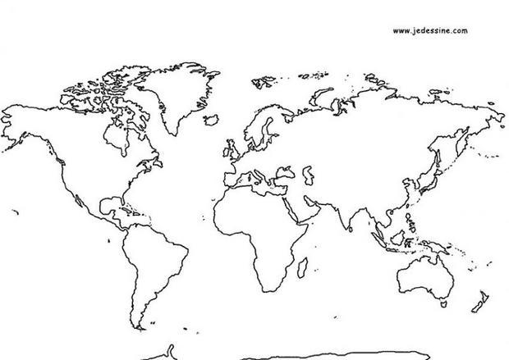
New Zealand

Slide 6
New Zealand

Slide 7
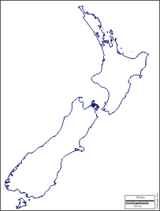
New Zealand

Slide 8
New Zealand
Auckland

Slide 9
New Zealand
Auckland
Roturoa

Slide 10
New Zealand
Auckland
Roturoa
Taupo

Slide 11
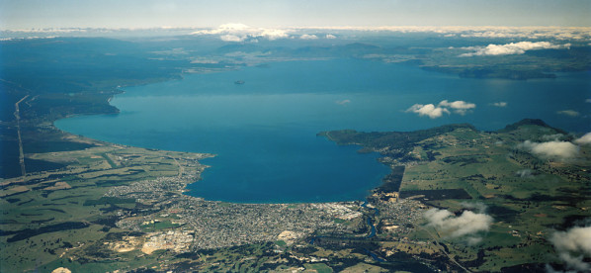
New Zealand
Auckland
Roturoa
Taupo

Slide 12
New Zealand
Auckland
Roturoa
Taupo
Wellington

Slide 13
New Zealand
Auckland
Roturoa
Taupo
Wellington
Queenstown

Slide 14
New Zealand
Auckland
Roturoa
Taupo
Wellington
Queenstown

Slide 15

New Zealand
The ALL BLACKS

Slide 16

New Zealand
The ALL BLACKS
The fern

Slide 17
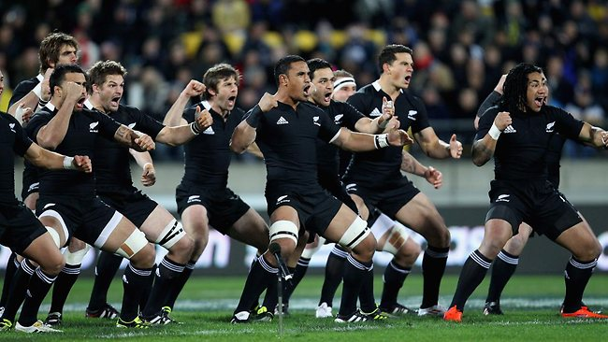
New Zealand
The ALL BLACKS
The fern
The hacka

Slide 18
New Zealand
The ALL BLACKS
The fern
The hacka

Slide 19

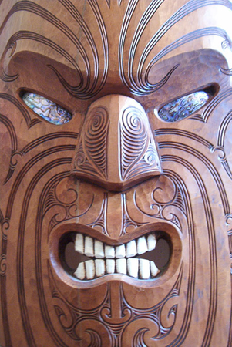
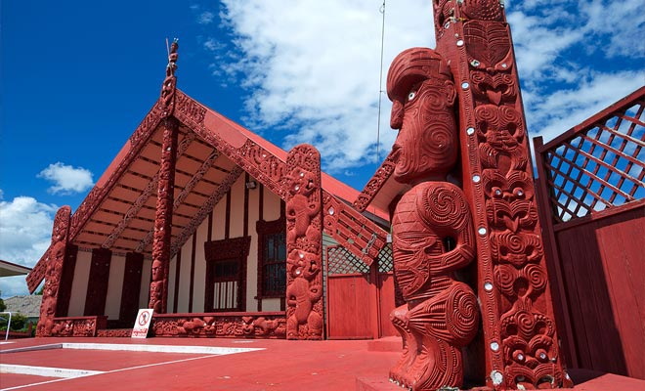
New Zealand
The Maori art

Slide 20
2.
Schooling

Slide 21

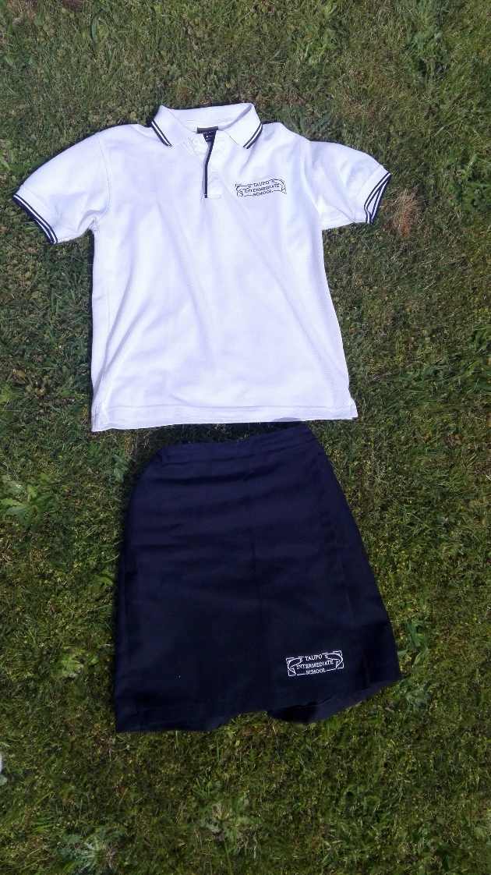
Schooling
Taupo Intermediate School

Slide 22
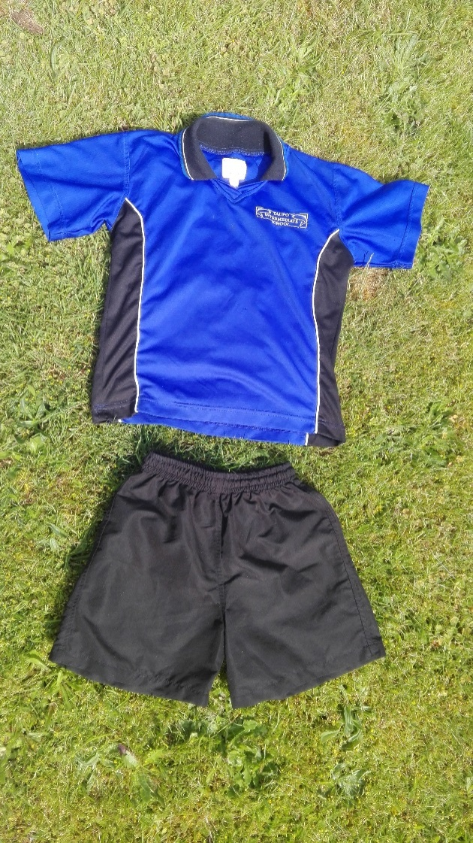
Schooling
Taupo Intermediate School

Slide 23
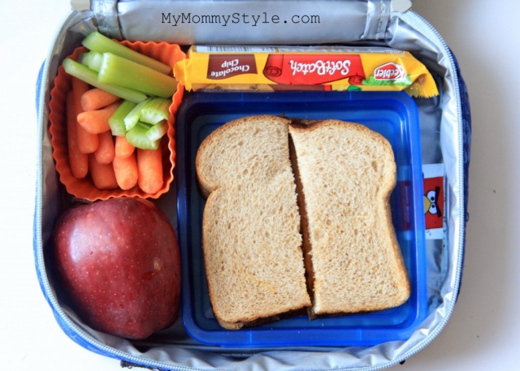
Schooling
Taupo Intermediate School

Slide 24
Schooling
Taupo Intermediate School

Slide 25
Schooling
Taupo Intermediate School
Subjects :
English - Reading
- Maths - Stuff
- ICT - Spelling
Social Studies - Technology
Cooking - sewing
science

Slide 26
Schooling
Taupo Intermediate School
Hours :
9:05 / Start
11:25 / Interval
12:55 / Lunch
3:00 / Finish
Subjects :
English - Reading
- Maths - Stuff
- ICT - Spelling
Social Studies - Technology
Cooking - sewing
science

Slide 27
Schooling
Taupo Intermediate School
Hours :
9:05 / Start
11:25 / Interval
12:55 / Lunch
3:00 / Finish
Matter :
English - Reading
- Maths - Stuff
- ICT - Spelling
Social Studies - Technology
Cooking - sewing
science

Slide 28
With my school

Slide 29
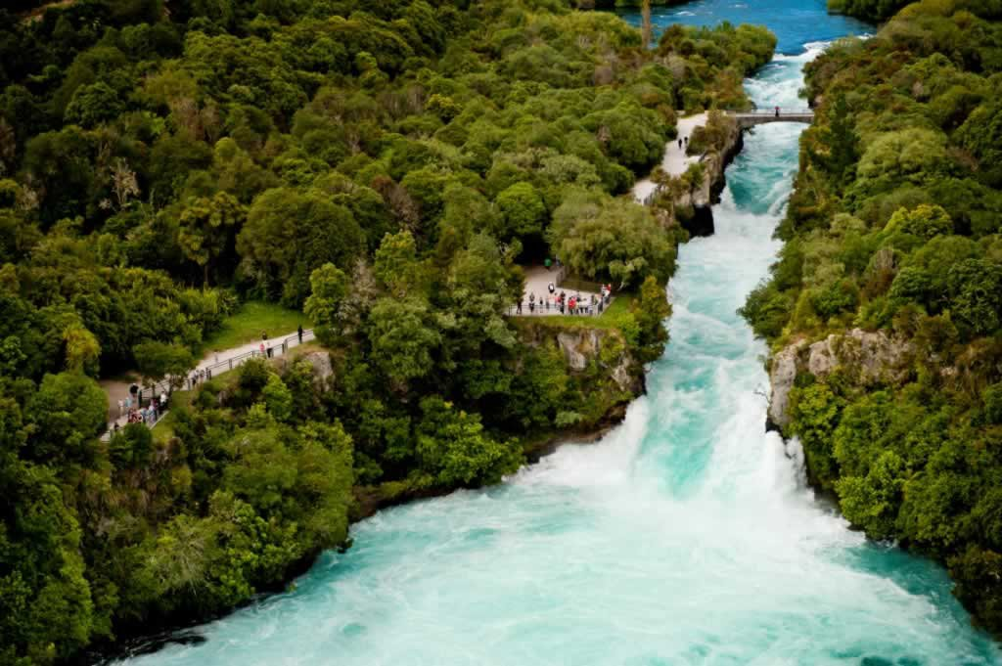
With my school
The huka falls

Slide 30
With my school
The huka falls

Slide 31
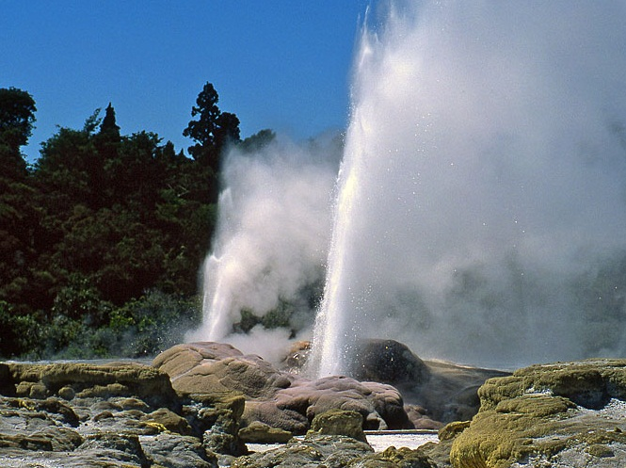
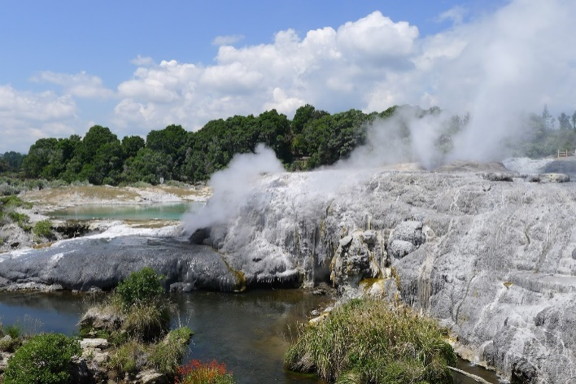
With my school
The geyser
The huka falls

Slide 32
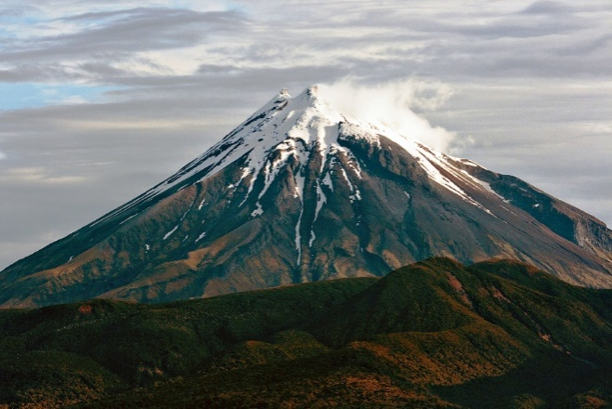
With my school
The geyser
The Volcanic Center
The huka falls

Slide 33
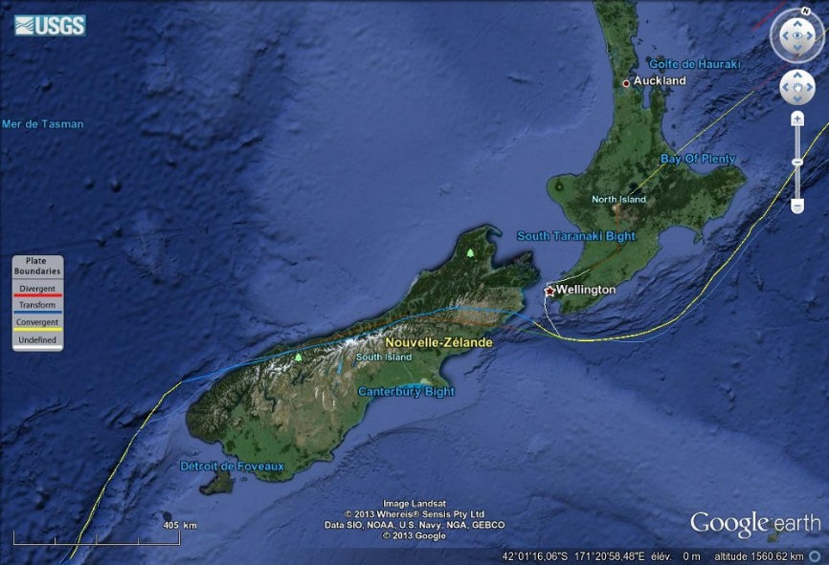
With my school
The geyser
The Volcanic Center
The huka falls

Slide 34
With my school
The geyser
The Volcanic Center
The huka falls

Slide 35
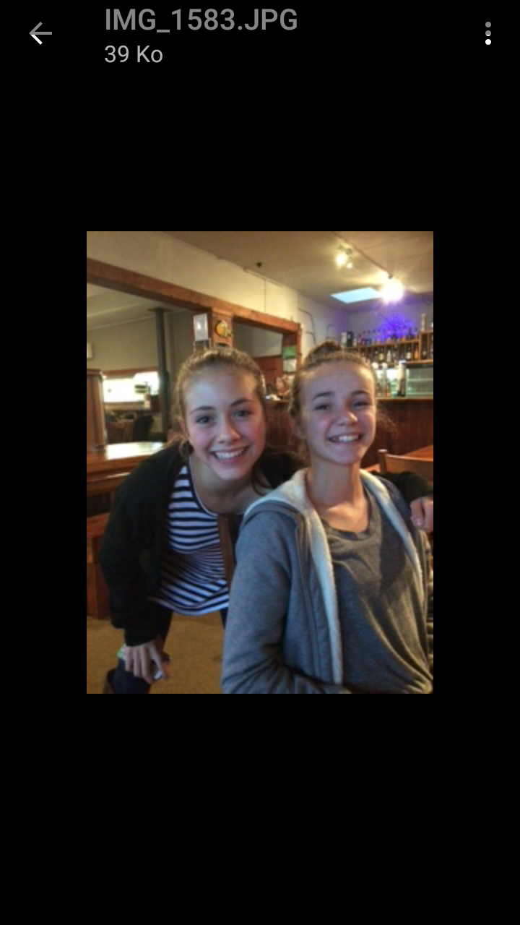
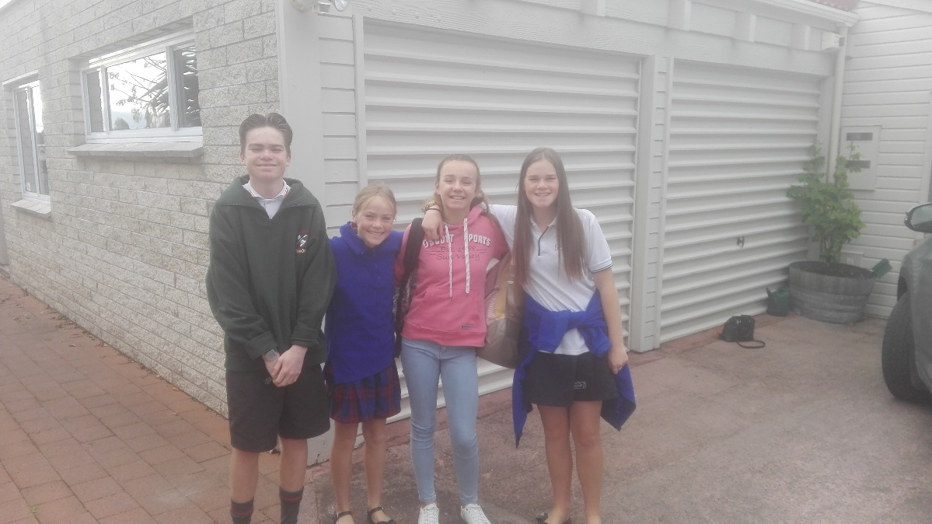
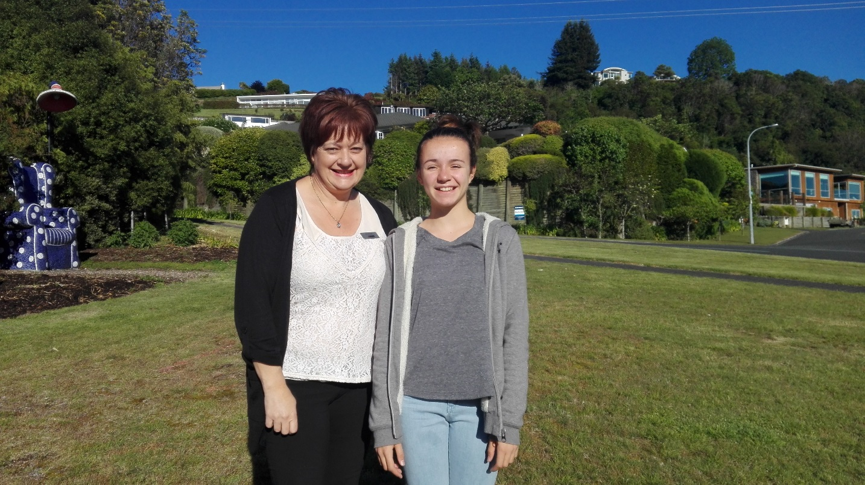

Slide 36
Thank you for your attention !

